Slide 1
20-25 chances
For breakdown
For infection
For scarring
Notes:
Every year we learn additional places to put electrodes to improve seizure recognition. For each and every electrode we increase our patient’s risk of skin breakdown, their risk of infections and permanent scarring. This picture is of my son Isaac. He had his first EEG at age 3 years old. His head was rubbed so vigorously that he had scabs at each site. These scabs lasted more than 2 months. The salt jelly injected into each of the electrodes caused pain for him. The most traumatic part was that he and I had discussed this procedure before I took him to the test. I had convinced him that he had nothing to worry about. I had been doing EEGs for more than 5 years at this point and had never left a scratch on a patient. I also had never needed to use a blunt tipped needle to do a test. Obviously, this clinic did the prep differently. He was partially sedated with Chloral hydrate and felt dopey instead of tired. It was a terrible experience for us both. The picture you see here was taken after I hooked him up myself for his follow up EEG, refusing to take him elsewhere for the next one. We had a grand time. What memories are you leaving for your patients? Are you leaving them with positive experiences, unafraid to return for their next EEG? Other patients, those in the ICU, fare much worse with skin breakdown. Immobile, critically ill patients with pressure injuries require longer hospital stays and some suffer life-threatening infections according to the Agency for Healthcare Research and Quality. Pressure injuries result in treatment costs of more than 11 billion dollars annually.

Slide 2
Skin Safety in the ICU
Petra N. Davidson, B.S., R. EEG/EP T., FASET
EEG Clinical Coordinator
IntraNerve Neuroscience
pdavidson@intranerve.com
Notes:
A study in the journal of Physiotherapy published in September 2017 demonstrated that allied health professionals report the following barriers to participation in pressure ulcer prevention: resources, equipment and education. I was honored to be a co-chair with Sharyn Katz for the Skin Safety Task Force within the Standards and Practices Committee of ASET. Our task force has completed all the directives given to us by the Board of Trustees. The work of the task force addresses all these barriers. Available for free on the ASET website, you can find guidelines, research and a class on how to prevent skin breakdown in the ICU. An addendum was published highlighting special care for neonates. This lecture highlights the findings of the Skin Safety Task Force as well as additional tools available online to those healthcare professionals willing to learn how to use them.

Slide 3
Evidence based medicine
Jo Ann Coryell, R. EEG T., CNIM, Alexis Gerber, R. EEG T., CLTM, Sameh Morkous, MD, FAAP, FAAN from Lehigh Valley Health Network 2018 ASET poster
From 10 incidents to 0
Additional changes to go beyond
Notes:
Jo Ann Coryell, R. EEG T., CNIM, Alexis Gerber, R. EEG T., CLTM, Sameh Morkous, MD, FAAP, FAAN published a poster at the annual ASET conference last year demonstrating the value of the Skin Safety Guideline.
Despite growing from 689 to 1810 procedures in 1 year, they have decreased their skin breakdown from 10 to 0.
This improvement spurred further action in their team to suggest additional changes to their protocol. All patients under 1 year of age are preppred only with disposable leads. Electrode replacement every 72 hours for adults and every 48 hours for pediatrics. Tape is allowed only on the eyes leads and is replaced daily. The Skin Safety Task Force and Standards and Practices Committee are elated to see teams coming forward with significant improvements in patient care and absolutely thrilled to see additional changes raising the bar to a higher standard of care for our patients.

Slide 4
Healthy Intact Skin
Monitoring Tools
Understanding Etiology
Neurodiagnostic Technology
MDRPU
NPUAP
MAUDE
PUSH
Notes:
Raise your hand if you understand all the acronyms on this slide. Now keep them raised if you understand the relationship between those acronyms and the three words in the bubbles. They are centered around NDT because every word up there is related to what we do every day. It is related to every aspect of Neurodiagnostic Technology. And NDT in the ICU means that our patients have a greater risk of injury simply because they are in the ICU. During this presentation, you will learn what each acronym means, its relation to NDT and how you can help reduce the risk of pressure injury and skin breakdown in the ICU.

Slide 5
Skin Breakdown in the ICU
Defining
Definitions unique to Pressure Ulcers
MDRPI
Monitoring
NDT & Pressure Ulcers
Preventing
Understand How
Improve Prep
NPUAP
PUSH
Regular Skin Checks
Positioning tools
Documentation
Relationship to monitoring tools
Evaluation of Processes
MAUDE
Notes:
We will begin with defining the acronyms unique to pressure injury and the scales used in defining, monitoring and preventing pressure injury. Next we will apply those definitions to monitoring techniques in the ICU and finally we will employ the monitoring techniques to prevent pressure injury in the ICU.

Slide 6
Skin Breakdown in the ICU
Defining
Definitions unique to Pressure Ulcers
MDRPI
NPUAP
PUSH
MAUDE

Slide 7
Skin Breakdown in the ICU
NDT & Pressure Ulcers
Monitoring
Relationship to monitoring tools
Notes:
We will begin with defining the acronyms unique to pressure injury and the scales used in defining, monitoring and preventing pressure injury. Next we will relate those definitions to our application of NDT in the ICU and finally we will discuss how to prevent pressure injury in the ICU.

Slide 8
Skin Breakdown in the ICU
Preventing
Improve Prep
Regular Skin Checks
Positioning tools
Documentation
Evaluation of Processes
Notes:
We will begin with defining the acronyms unique to pressure injury and the scales used in defining, monitoring and preventing pressure injury. Next we will relate those definitions to our application of NDT in the ICU and finally we will discuss how to prevent pressure injury in the ICU.

Slide 9
Definitions
Pressure injury
Pressure ulcer
Skin breakdown
Skin integrity
Bed sores
Decubitus ulcers

Slide 10
Skin breakdown
Pressure injury
Sometimes preventable, sometimes unavoidable
Unintended, injury to the skin surface or deeper
Reversible or irreversible; reddening to deep wound

Slide 11
Defining
MAUDE
NPUAP
MDRPI
PUSH
PU, PI, DU
Notes:
The MDRPU was first defined by the NPUAP who developed the PUSH. Let’s break that down. The National Pressure Ulcer Advisory Panel was developed in 1986 and is comprised of specialists from many different areas of healthcare. This group is a national non-profit organization designed to bring attention to pressure injuries with a sole goal of eliminating them. They do this not only through research and collaboration but also through providing education for medical providers and the general public. They offer free education on their website.
The NPUAP describes MDRPI, also known as MDRPU, as any pressure injury that is a direct result of a medical device. This term has an ICD-10 code and is a billable etiology. The NPUAP also developed a scale to help healthcare professionals track and monitor pressure injuries over time, known as the PUSH. It is available on their website for free.

Slide 12
MAUDE
Manufacturer And User Facility Device Experience
FDA website https://www.fda.gov/medical-devices/device-advice-comprehensive-regulatory-assistance/medical-device-databases
Comprehensive list of all user voluntarily submitted reports of adverse events regarding medical devices or products
Includes commercially available NDT products

Slide 13
Adverse events
FDA: undesirable outcome to a patient caused by a medical device
NIH: any untoward or unfavorable medical occurrence
IHI: adverse drug events as well as any unintended event occurring in association with medical care to patients in an ICU

Slide 14
NPUAP
National Pressure Ulcer Advisory Panel
https://npuap.org/page/QuickFacts
Interprofessional group dedicated improving patient outcomes through education, policy & research
Define the stages of pressure injury
Sharing tools on monitoring pressure injury

Slide 15
MDRPU
Medical devices associated with adverse incidents in diagnostic and therapeutic use
Includes breakdown or malfunction of medical devices
https://www.icd10data.com/ICD10CM/Codes/V00-Y99/Y70-Y82
Notes:
The official CPT code definition for MDRPU is any injury resulting from medical device use associated with adverse incidents in diagnostic and therapeutic use when used appropriately. This includes the period the device was in use and after the device was removed.

Slide 16
PUSH
https://npuap.org/page/PUSHTool
Notes:
PUSH is a tool designed by the NPUAP to identify, track and monitor healing stages of a pressure injury. This information is used to assess healing of the patient and to develop a consistent language to improve communication across healthcare disciplines. PUSH stands for Pressure Ulcer Scale for Healing. NPUAP offers this tool free of charge on their website along with the tools necessary to properly employ the tool and follow up with any injuries.

Slide 17
Pressure Injuries
Defining the stages of pressure injuries, pressure ulcers, decubitus ulcers
Notes:
NPUAP updated definitions will be provided for proper educational purposes. A pressure injury is localized damage to the skin and underlying soft tissue usually over a bony prominence or related to a medical or other device. The injury can present as intact skin or an open ulcer and may be painful. The injury occurs as a result of intense and/or prolonged pressure or pressure in combination with shear. The tolerance of soft tissue for pressure and shear may also be affected by microclimate, nutrition, perfusion, co-morbidities and condition of the soft tissue.

Slide 18
Caution graphic images
Notes:
I want to caution those of you with a weak stomach that some of the following slides may be disturbing. They demonstrate what can happen in pressure related injuries.

Slide 19
Healthy skin

Slide 20
Pressure injuries from electrodes
Leads
Forehead pressure injury
Forehead shear and pressure injury
Notes:
Electrodes can cause both pressure injury and shear injury. Cathy Hess, BSN, RN, CWOCN writes for an article in Skin and Wound Care, friction and shear are mechanical forces which result in pressure ulcer formation through tissue ischemia and ulcer development. Shear forces act parallel to the skin surface and causes damage beneath the tissues resulting in an injury that cannot be seen immediately. Friction forces are a result of a coarse material being drug across the surface of the skin resulting in reddening and edema. Electrode cups and leads can cause pressure, friction and shear, as can the skin preparation process and the skin prep materials.
When these processes are coupled with critically ill patients whose nutrition and lack of movement cause an increased risk to skin breakdown the risk is raised even further. The initial suspicions of the SSTF that environmental conditions such as humidity played a role in skin breakdown were confirmed through research published in the last few years, it is expected that patients whose heads have been wrapped tightly, are profusely sweaty and immobile are more at risk as well.

Slide 21
Blanchable vs Non-blanchable
Notes:
Blanch Test:
Apply light pressure. Skin should blanch or lighten.
Release. Skin should return to normal color due to normal reactive hyperemia.
Blanchable: Skin blanches with pressure. Color returns immediately with release. Non-blanchable: No blanch, persistent redness in lightly pigmented skin.

Slide 22
Stage I
Notes:
Stage 1 Pressure Injury: Non-blanchable erythema of intact skin Intact skin with a localized area of non-blanchable erythema, which may appear differently in darkly pigmented skin. Presence of blanchable erythema or changes in sensation, temperature, or firmness may precede visual changes. Color changes do not include purple or maroon discoloration; these may indicate deep tissue pressure injury.

Slide 23
Stage II
Notes:
Stage 2 Pressure Injury: Partial-thickness skin loss with exposed dermis Partial-thickness loss of skin with exposed dermis. The wound bed is viable, pink or red, moist, and may also present as an intact or ruptured serum-filled blister. Adipose (fat) is not visible and deeper tissues are not visible. Granulation tissue, slough and eschar are not present. These injuries commonly result from adverse microclimate and shear in the skin over the pelvis and shear in the heel. This stage should not be used to describe moisture associated skin damage (MASD) including incontinence associated dermatitis (IAD), intertriginous dermatitis (ITD), medical adhesive related skin injury (MARSI), or traumatic wounds (skin tears, burns, abrasions).

Slide 24
Stage III
Notes:
Stage 3 Pressure Injury: Full-thickness skin loss Full-thickness loss of skin, in which adipose (fat) is visible in the ulcer and granulation tissue and epibole (rolled wound edges) are often present. Slough and/or eschar may be visible. The depth of tissue damage varies by anatomical location; areas of significant adiposity can develop deep wounds. Undermining and tunneling may occur. Fascia, muscle, tendon, ligament, cartilage and/or bone are not exposed. If slough or eschar obscures the extent of tissue loss this is an Unstageable Pressure Injury

Slide 25
Stage IV
Notes:
Stage 4 Pressure Injury: Full-thickness skin and tissue loss Full-thickness skin and tissue loss with exposed or directly palpable fascia, muscle, tendon, ligament, cartilage or bone in the ulcer. Slough and/or eschar may be visible. Epibole (rolled edges), undermining and/or tunneling often occur. Depth varies by anatomical location. If slough or eschar obscures the extent of tissue loss this is an Unstageable Pressure Injury

Slide 26
Unstageable
Notes:
Unstageable Pressure Injury: Obscured full-thickness skin and tissue loss Full-thickness skin and tissue loss in which the extent of tissue damage within the ulcer cannot be confirmed because it is obscured by slough or eschar. If slough or eschar is removed, a Stage 3 or Stage 4 pressure injury will be revealed. Stable eschar (i.e. dry, adherent, intact without erythema or fluctuance) on the heel or ischemic limb should not be softened or removed.
Deep Tissue Pressure Injury: Persistent non-blanchable deep red, maroon or purple discoloration Intact or non-intact skin with localized area of persistent non-blanchable deep red, maroon, purple discoloration or epidermal separation revealing a dark wound bed or blood filled blister. Pain and temperature change often precede skin color changes. Discoloration may appear differently in darkly pigmented skin. This injury results from intense and/or prolonged pressure and shear forces at the bone-muscle interface. The wound may evolve rapidly to reveal the actual extent of tissue injury, or may resolve without tissue loss. If necrotic tissue, subcutaneous tissue, granulation tissue, fascia, muscle or other underlying structures are visible, this indicates a full thickness pressure injury (Unstageable, Stage 3 or Stage 4). Do not use DTPI to describe vascular, traumatic, neuropathic, or dermatologic conditions.

Slide 27
Monitoring
Relationship between NDT and Pressure Ulcers
Use the relationship to determine monitoring tools
Healthier skin, healthier patients
Notes:
Next, we need to understand the relationships between skin breakdown and our own tools and processes in order to recognize etiologies of skin breakdown. Recognizing etiologies allows the development of proper tools to monitor, track and prevent skin breakdown.

Slide 28
Monitoring
ASET SSTF 2016
SSTF conducts literature review & survey
Literature rev. & survey determine common etiologies
Common etiologies lead to SSTF Guideline
Guideline leads to a course on skin safety
Course & Guideline lead to reduce breakdown
Notes:
By utilizing tools created by ASET’s SSTF, Skin Safety Task Force, we reduce a great amount of work. A thorough literature review and multisite survey lead the SSTF to the conclusion that the majority of instances of preventable skin breakdown was due to over-abrasion of the skin and the length of time between skin checks. The SSTF provided a guideline to aide facilities in sculpting processes designed in reducing skin breakdown. Further research has uncovered that it is not always possible to avoid skin breakdown.

Slide 29
Tools available through ASET
Skin safety in cEEG Guideline
Neonatal Addendum
Skin Safety Video
Skin Safety Course
Poster presentations and journal articles by the SSTF

Slide 30
Monitoring
https://cdn.ymaws.com/npuap.site-ym.com/resource/resmgr/position_statements/npuap-position-statement-on-.pdf
NPUAP Position Statement 2 reports that not all pressure ulcers are avoidable, despite the best possible care.
The etiology of pressure ulcers are multifactorial and include nutrition, position, humidity, pressure and materials used.
Notes:
The NPUAP Position statements include a very concise thesis statement regarding the inevitability of some pressure ulcers. Our goal is to prevent as many pressure ulcers as possible but understand that there will be some even when the best bedside care is provided. Monitoring and preventing pressure ulcers is an interdisciplinary team effort.

Slide 31
YOU/ Your Facility
NPUAP
ASET
AHRQ
Monitoring
Notes:
Together, you, ASET and NPUAP are a team. NPUAP has established tools available on their website for monitoring skin integrity. Utilizing common tools enables providers to share a common language and further reduce skin breakdown through the identification of common etiologies. These tools include the PUSH, pressure ulcer scale for healing, among many more. Authors from Bruin Biometrics, assess 17 skin breakdown tools and determine that in most cases a combination of skin assessment tools are required to prevent skin breakdown. They suggest that monitoring is important but developing a proper proactive care plan is much more useful. The AHRQ, Agency for Healthcare Research and Quality, provides a free toolkit on their website to facilitate the process of developing a skin safety protocol within your facility.

Slide 32
AHRQ- Agency for healthcare research and quality
https://patientcarelink.org/wp-content/uploads/2015/10/AHRS-Patient-Safety-Tools.pdf
https://patientcarelink.org/wp-content/uploads/2015/10/Pressure-Ulcer-Teaching-guide.pdf
https://patientcarelink.org/wp-content/uploads/2019/07/HAPI-Resources.pdf

Slide 33
National Pressure ulcer advisory panel

Slide 34
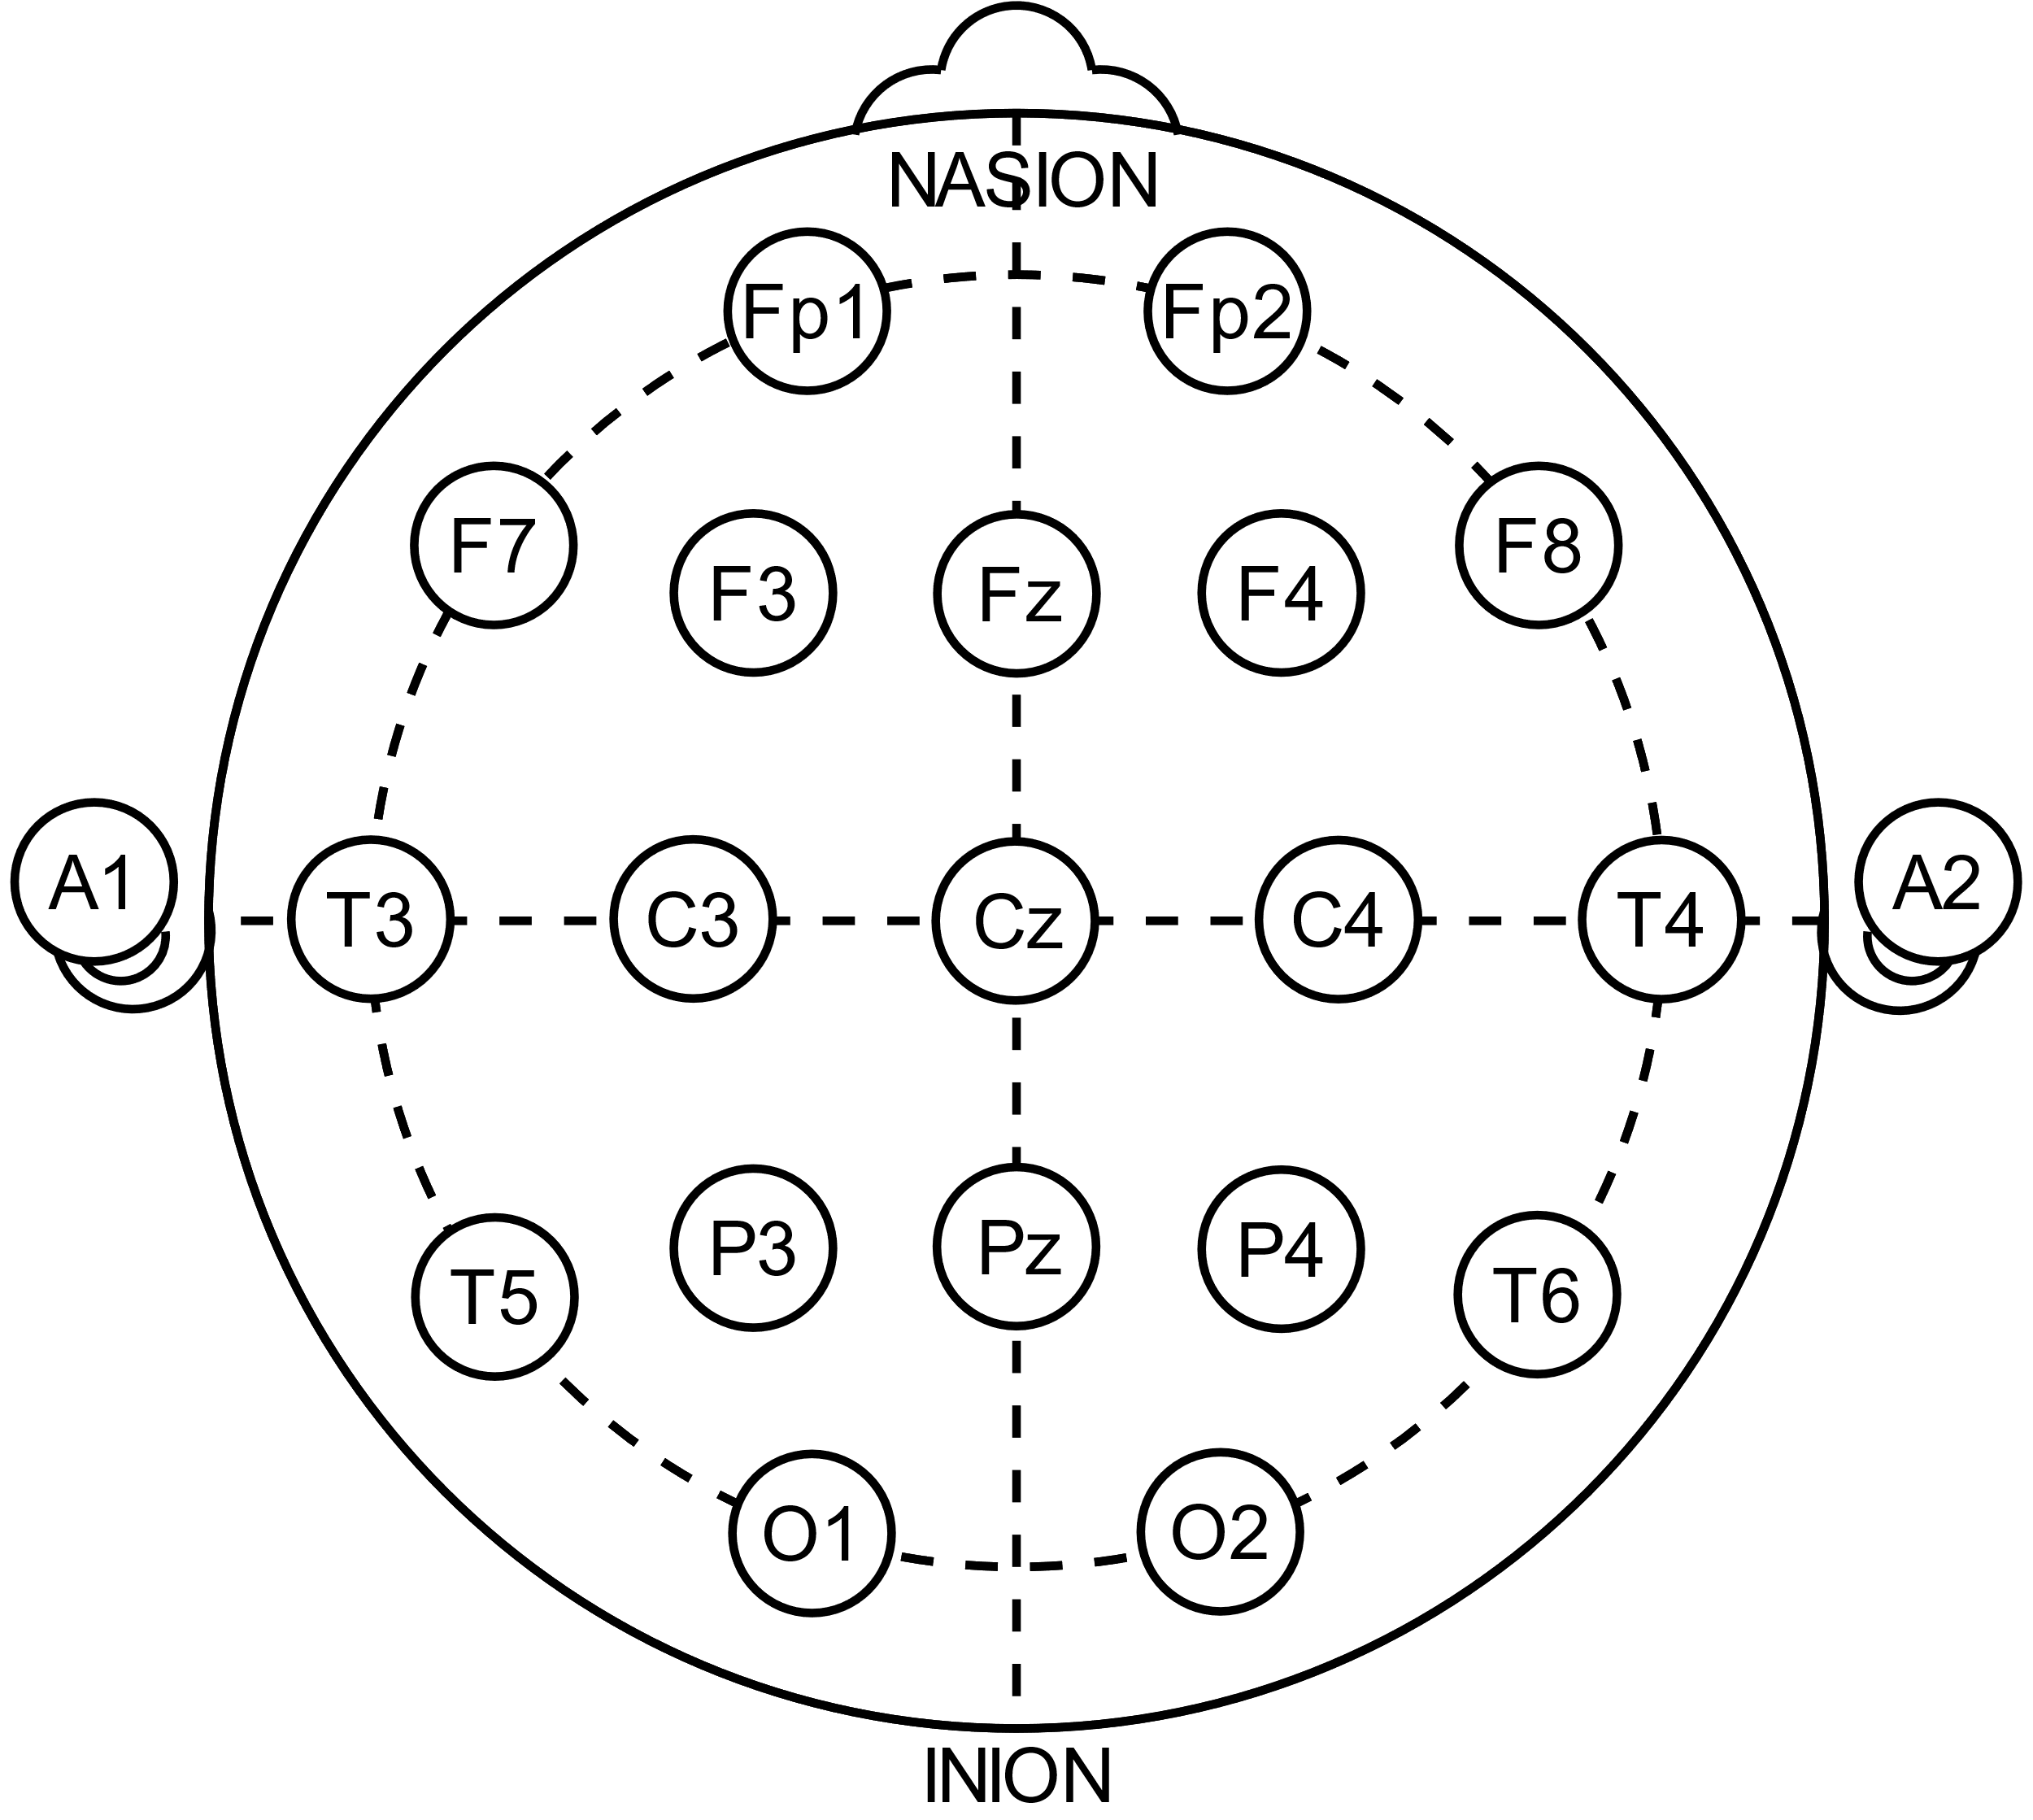
Your own facility
EMR will most likely have a skin integrity form
Wound care nurses are happy to help you track pressure injuries
Talk to your ICU RNs, they can help you find the documentation forms
Take a copy of this form to the RN/Wound Care – use it as a base for a proper pressure ulcer tracking tool

Slide 35
Preventing Pressure Injuries
PU prevention in cEEG in the ICU
Ease up on the prep
Regular Skin Checks
Positioning tools
Documentation & Evaluation of Processes
Notes:
The last segment of this talk will provide the known etiologies of skin breakdown or pressure ulcers in the ICU during cEEG monitoring. The latest research shows those who have implemented the ASET SSTF Guideline on Skin Safety are seeing measurable reductions in skin breakdown. There is still room to grow as skin breakdown has not been eliminated but has been greatly reduced.

Slide 36
Preventing at healthy skin
Healthy Skin
Stage I
Stage III
Stage III
Notes:
Healthy skin is smooth, with no breaks in the surface. It is warm (not hot or red) and neither dry and flaky nor moist and wrinkled.
http://sci.washington.edu/info/pamphlets/skin_1.asp
Pressure ulcers, skin breakdown, skin injury are evident when any quality of healthy skin is missing. Redness, irritation, loss of dermis, edema or excessive heat.
Learning to communicate the first signs of pressure ulcers to other staff and documenting it is the first step in prevention.

Slide 37
Skin Safety in the ICU
petradavidsonreegept@gmail.com
Petra N. Davidson, R. EEG/EP T., FASET
IntraDiagnostics, LLC
ASET, Standards & Practices Committee

