Slide 1
CLTM Exam Prep
Jennifer Vierkant, BS, R.EEG/EPT., CLTM, RPSGT
Notes:
Good afternoon! Today I am going to be reviewing

Slide 2
Objectives
Review CLTM exam eligibility requirements
Provide direction for useful study material
Overview of exam content
Important need-to-knows
Helpful hints to help you prepare and pass the exam

Slide 3
CLTM Exam Eligibility Requirements
R. EEG T. Credential
One year of LTM experience after R. EEG T. is obtained
Documentation of 50 LTM cases
Refer to www.abret.org for specifics
Current BLS

Slide 4
CLMT Exam Content
200 Questions
4 hours to complete
Exam is weighted as follows:
Pre-Study Preparation 25%
Performing the Study 65%
Post-Study Procedures 10%

Slide 5
Exam Content

Slide 6
Study Resources
ABRET ASAP Program
ABRET CLTM Exam Handbook
Content outline
References
ACNS Guideline 12 Long-Term Monitoring For Epilepsy
ACNS Guideline 14 Standardized Critical Care EEG Terminology
Infection Control 2013
(found on ASET website)
ASET - LTM 109 LTM & ICU Monitoring Final Review and Practice Exam Course
ASET Recommended Books
Continuous EEG in Adult Patients
Acute EEG/cEEG ICU Monitoring
Knowledge Plus CLTM Board Prep Course

Slide 7
Study Resources
Joint Commission www.jointcommission.org
National Patient Safety Goals
2 patient identifiers when providing care, treatment and services
Preferred method of hand sanitization when you have no visible soiling of your hands?
Universal protocol for preventing Wrong-site, Wrong-person, Wrong-procedure Surgery:
Right Patient
Right Medication
Right Surgery
Right Side Surgery

Slide 8
Study Resources
Occupational Safety and Health Administration (OSHA) https://www.osha.gov
Material Safety Data Sheet (MSDS)
Biomedical Chassis Leakage Current Records
Calibration Logs

Slide 9
Seizure Classification

Slide 10
Seizure Classification
International League Against Epilepsy (ILAE) www.ilae.org
The most widely used and accepted classification of epileptic seizures
Defines seizure types only in terms of clinical manifestations and EEG findings
Notes:
I would encourage everyone to visit the ILAE website and be familiar with the most recent seizure classifications and terminology that was updated in 2017. Lee Wolfinbarger gave an excellent presentation on the ILAE updates yesterday in the EEG course, so that would be a good resource for you as well and will be included in the meeting DropBox link.
I am not going to review this in-depth today as there is a lot of material to cover, but we will briefly review it, as well as what is considered the “old seizure classification and terminology”.

Slide 11
Seizure Classification
Seizure
A sudden, involuntary time-limited alteration in behavior, including a change in motor activity, autonomic function, consciousness or sensation, accompanied by abnormal electrical activity in the brain
Epilepsy
2 or more seizures
No Underlying Cause

Slide 12
Seizure Classification
2017 ILAE Updates

Slide 13
Seizure Classification (old classifications)
Partial Seizures
Partial seizure without impairment
Partial seizure with impairment
Generalized Seizures
Absence
Tonic
Clonic
Tonic-Clonic
Myoclonic
Atonic

Slide 14
Aura
Subjective sensation that is considered a simple partial seizure.
Brief in duration
Helps determine the site of cortical onset
Precede temporal lobe seizures in 80% of cases
8 different varieties are recognized:
Visual
Auditory
Gustatory
Somatosensory
Olfactory
Psychic
Autonomic
abdominal
Notes:
They aid in determining the site of cortical onset, especially with temporal lobe epilepsy as auras have been found to precede temporal lobe seizures in 80% of cases.
There are 8 different auras recognized. Who can name one?

Slide 15
Seizure Classification
Status Epilepticus
A seizure or series of seizures that continue for at least 5 minutes without return of consciousness between seizures
Considered a medical emergency
Non-Epileptic Events
Events that are not generated by the brain, and do not involve abnormal, rhythmic discharges of cortical neurons

Slide 16
Seizure Classification
Idiopathic Epilepsy
Epilepsy syndromes with specific age related onset, clinical and electrographic characteristics, and a presumed genetic mechanism
Symptomatic Epilepsy
Seizure caused secondarily by a previously known or suspected CNS disorder

Slide 17
Seizure Classification
Term Definition
Ictal EEG
During the event
Interictal EEG
Time in between the event
Postictal EEG
Period of time immediately following an event

Slide 18
Seizure Classification
Abnormal EEG Waveforms
Slow Wave
Frequency: 0-4Hz
Duration: > 200ms
Sharp Wave
Frequency: 5-14Hz
Duration: 70-200ms
Spike
Frequency: 14-50Hz
Duration: 20-70ms
Notes:
You 100% need to be able to differentiate these waveforms, and know their typical frequency and duration ranges.

Slide 19
Seizure Classification
Syndrome | Onset | Prevalence | Seizure Type | Activation | Medication
Absence Epilepsy | 3-12 yrs | 8% | Absence 3Hz spike & wave | HV | Ethosuximide
Benign Rolandic Epilepsy | 2-13 yrs | 15-20% | Nocturnal GTC Hemiclonic | Sleep | May not medicate
Benign Occipital Epilepsy | 15 mo – 15 yrs | Rare | Visual | E/O enhances Sleep inhibits | Various AED
Dravet Syndrome (SCN1A mutation) | 1-12 mo | Rare | Severe Myoclonic Epilepsy of Infancy (SMEI) | N/A | Valproic Acid Topiramate
Juvenile Myoclonic Epilepsy (Chromosome 6) | 12-18 yrs | 5% | Myoclonic GTC Absence | N/A | Valproic Acid
Landau-Kleffner Syndrome | 2-13 yrs | Rare | GTC Myoclonic Absence | Sleep – ESES is seen | Steroids Various AED
Lennox-Gastaut | 1-8 yrs | 3-10% | Tonic Atonic Absence Drop | N/A | Valproic Acid
West’s Syndrome | < 1 yr | Rare | Infantile Spasms | N/A – EEG shows Hypsarrhythmia | Adrenocorticotropic Hormone (ACTH) Steroids
Notes:
These are all important Epilepsy Syndromes to familiarize yourself with, and are commonly found on the exam.

Slide 20
Anatomy & Seizures

Slide 21
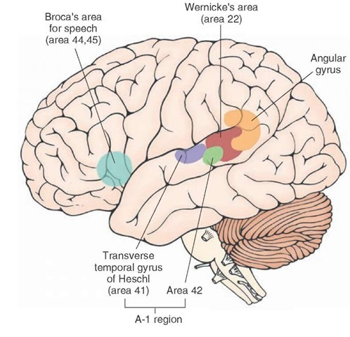
Anatomy & Seizures
Broca’s Area
Expressive Speech
Wernicke’s Area
Receptive Speech
Transverse Temporal Gyrus
AKA: Heschl’s Gyrus
Primary Auditory Cortex
Angular Gyrus
Processes related to Language
Number Processing
Spatial Recognition
Memory Retrieval
Attention
Notes:
B comes before W in the alphabet….. Just like Frontal lobe comes before temporal lobe.

Slide 22
Anatomy & Seizures
Insula
Deep within lateral fissure between temporal and frontal lobes
Function
Perception, motor control, self-awareness, interpersonal experience, regulation of homeostasis, consciousness, emotion
Notes:
Who can tell me where the insula is located in the brain?
What is it’s function?

Slide 23
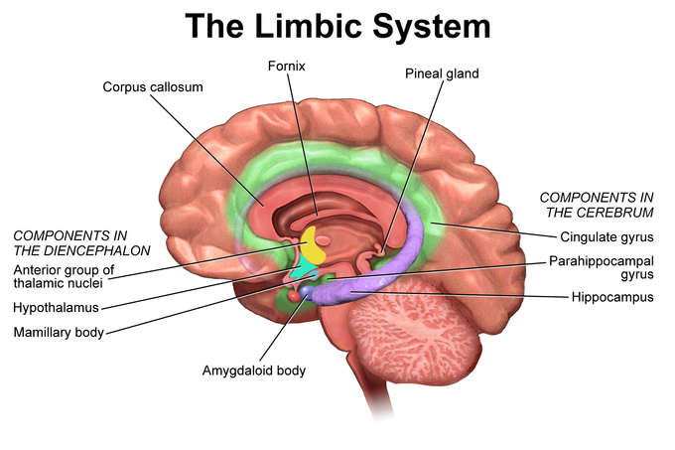
Anatomy & Seizures
Limbic System
Hippocampus, Amygdala, Anterior Thalamic Nuclei
Deep within medial temporal lobe
Functions
Emotion
Behavior
Long Term Memory
Olfaction
Notes:
What structures comprise the limbic system?
Where are they located?
What are the functions of the limbic system?

Slide 24
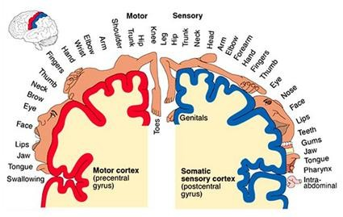
Anatomy & Seizures
Homunculus
Neurological map of the anatomical divisions of the body

Slide 25
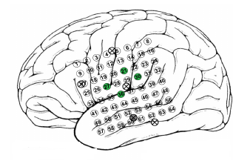
Anatomy & Seizures
Notes:
You may get a question with a picture example like this on your exam. It may ask you something along the lines of: “Which electrode is located in the primary sensory strip?” 30, 27, 36, or 21

Slide 26
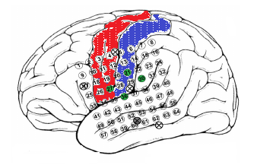
Anatomy & Seizures

Slide 27
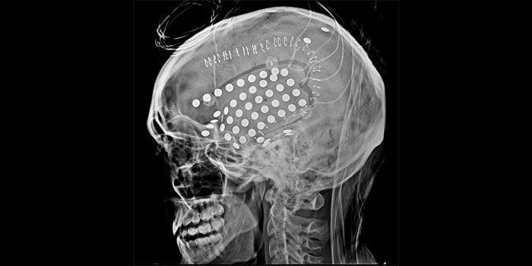
Anatomy & Seizures

Slide 28
Seizure Semiology
Clinical manifestations or symptoms
Notes:
Seizure semiology is an important part in aiding physicians localize seizure onset

Slide 29
Posterior Fossa
Small space in the back of the skull
Includes brainstem, cerebellum and fourth ventricle
Separated from cerebral hemispheres by the tentorium
Most common location for pediatric tumors
>60%
Medulloblastoma, cerebellar astrocytomas, brainstem gliomas, primitive neuroectodermal tumors (PNETs) and ependymomas
Can cause seizure activity

Slide 30
Neuroimaging

Slide 31
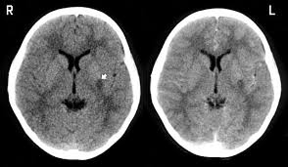
Neuroimaging
Important to remember…..
When looking at the MRI image:
Right is left side & left is right side

Slide 32
Neuroimaging
MRI
Considered the “Gold Standard” for assessing Hippocampal Sclerosis
Also known as Mesial Temporal Sclerosis (MTS)
Notes:
MRI is obviously a useful tool used in conjunction with other diagnostic testing our patient population, as it can detect many anatomical abnormalities. Can anyone tell me what MRI is considered the gold standard in assessing in relation to epilepsy or seizures.
MTS is the most common pathological finding in adults with temporal lobe epilepsy. It is rarely detected in children, and usually is not found until later in adolescence or early adult hood.

Slide 33
Neuroimaging
MRI
Tractography
3D modeling technique used to visually represent neural tracts using data collected by Diffusion Tensor Imaging (DTI)
Shows structural abnormalities
Notes:
DTI can provide a detailed understanding of white matter tract alterations, specifically in patients with temporal lobe epilepsy.

Slide 34
Neuroimaging
Functional Magnetic Resonance Imaging (FMRI)
Measures brain activity by detecting associated changes in blood flow
Maps sensory, motor, language
Notes:
FMRI measures brain activity by detecting associated changes in blood flow.
Can anyone tell me what it is used for in relation to epilepsy? It is useful for mapping sensory, motor, and language.

Slide 35
Neuroimaging
Positron Emission Tomography (PET) Scan
Imaging test that uses a radioactive substance, called a tracer, to look for a disease in the body
Common tracer: Fluorodeoxyglucose (FDG)
Helps reveal how your tissues and organs are functioning
Glucose metabolism
Hypometabolism
Notes:
Various PET studies, such as measurements of glucose, serotonin and oxygen metabolism, cerebral blood flow and receptor bindings are available for epilepsy. ¹⁸Fluorodeoxyglucose (¹FDG) PET imaging of brain glucose metabolism is a well established and widely available technique.
EEG is commonly recorded during FDG PET scans. Studies have demonstrated that the sensitivity of interictal FDG-PET is higher than interictal SPECT and similar to ictal SPECT for the lateralization and localization of epileptogenic foci in presurgical patients refractory to medical treatments who have noncontributory EEG and MRI. In addition to localizing epileptogenic focus, FDG-PET provide additional important information on the functional status of the rest of the brain.
The main limitation of interictal FDG-PET is that it cannot precisely define the surgical margin as the area of hypometabolism usually extends beyond the epileptogenic zone.

Slide 36
Neuroimaging
Single Photon Emission Computed Tomography (SPECT)
Measures blood flow and shows function of organs
Hypoperfusion
Notes:
Single photon emission computed tomography is used for measuring blood flow and showing the function of organs, including the brain. Where PET scans are used commonly in epilepsy to assess hypometabolism, SPECT scans are commonly used to assess areas of hypoperfusion in the brain.

Slide 37
Neuroimaging
Magneto-encephalography (MEG)
Functional neuroimaging technique for mapping brain activity by recording magnetic fields produced by electrical currents occurring naturally in the brain
Maps seizure focus, sensory, motor, language
Notes:
MEG can be a very useful tool used in conjunction with other diagnostic testing for epilepsy, specifically in relation to mapping certain functional areas of the brain.
Can anyone tell me what the MEG can map?

Slide 38
Neuroimaging
Notes:
This is a CT image of a patient with an intracranial electrode grid. You may see images like this on your exam.

Slide 39
Long Term Epilepsy Monitoring

Slide 40
Phases of LTM
Phase I
EMU
Surface electrodes
Expanded International 10-20 System
Phase II
EMU
Intracranial Electrodes
Surgical Candidates
Phase III
EMU
Epilepsy Surgery (resection)
Notes:
It is important to know the different phases of long term epilepsy monitoring, and understand what they entail for the patient.

Slide 41
Recording Methods in LTM
Surface Electrodes
Sphenoidal Electrodes
T1-T2
10-10 System
Intracranial Electrodes
Grids
Strips
Depth Electrodes
*Know where they are inserted, what area of brain they record from and what metals they are made out of!!!
Notes:
This information is laid out nicely in the ACNS Guideline 12

Slide 42
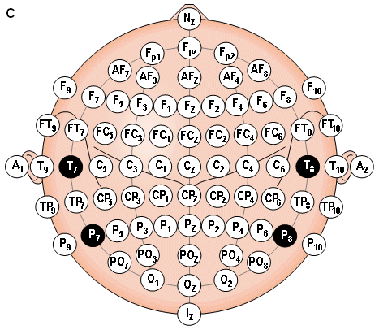
10-10 System
Know this!!!
Used for better localization of epileptiform activity
Notes:
I cannot stress enough how important it is to know the 10-10 system, specifically the inferior temporal chains. You will likely have questions on your exam

Slide 43
64 Channel EEG

Slide 44
Spike & Seizure Detection
Best manages using Laplacian Reference
Each electrode is referenced to an average of the electrodes directly surround it
Benefits:
Allows comparison of amplitude between channels for mapping
Effective for minimizing the effects of moderate artifact

Slide 45
Long Term Monitoring
Treatment Options
Medication
AED’s
Ketogenic Diet
VNS Stimulator
RNS
Surgical Treatment
Notes:
Responsive neruostimulation

Slide 46
Epilepsy Surgery

Slide 47
WADA Test
Performed during angiography in Interventional Radiology
Barbiturate via catheter from femoral artery
Brevital (Methohexital Sodium)
Used to establish dominant hemisphere for language and memory
90% of population is left hemisphere dominant
Also known as Intracarotid Sodium Amobarbital Test (ISAT)
Named after Canadian Epileptologist Juhn Wada
Notes:
What is a WADA test?
It is a procedure performed during angiography in Interventional Radiology. A barbiturate is administered via catheter in what artery?
What is the most common barbiturate used? Brevital (
What is the purpose of a WADA test? It is utilized to establish hemisphere dominance for language and memory. What hemisphere is typically dominant?
What is another name for the WADA test? Intracarotid sodium amobarbital test
Who was it named after?

Slide 48
Corpus Callosotomy
Disconnects right and left hemispheres of brain
Most helpful for atonic seizures, or “drop attacks”
Often seen in Lennox-Gastaut Syndrome
Notes:
Surgical procedure that disconnects the left and right hemispheres of the brain.
What type of seizures is this most helpful for?

Slide 49
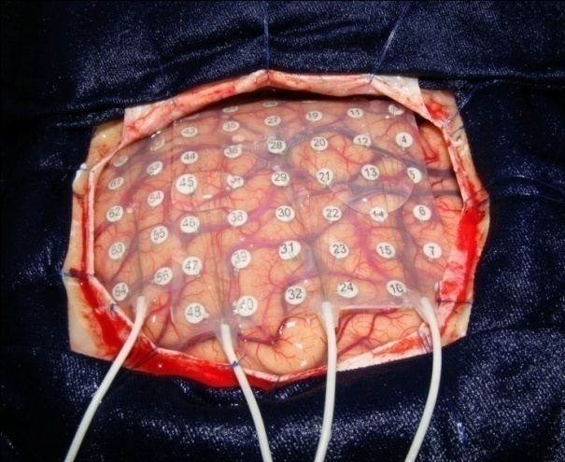
ECOG
Electrocorticography
EEG recorded directly from cerebral cortex
Functional mapping
Recommended Bandpass: 1-70 Hz
Default Sensitivity: 70-100 uV

Slide 50
Stereoelectroencephalography (SEEG)
Stereoelectroencephalography (SEEG) is an invasive surgical procedure that is used to identify areas of the brain where epileptic seizures originate.
Notes:
With SEEG, doctors place electrodes in targeted brain areas, which are then monitored to precisely locate seizure source. When the seizure onset is localized, a surgical resection and a good seizure outcome may be possible.
This surgical option extremely helpful in monitoring areas that are located deep within the brain, and it is less invasive for patients.

Slide 51
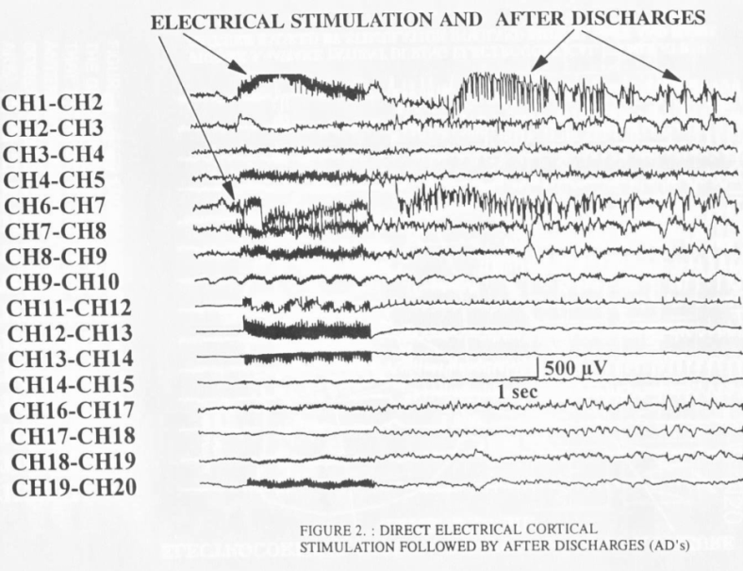
Direct Cortical Stimulation
Considered the “gold standard” to define eloquent cortex
Biphasic constant current stimulator
Parameters
Intensity Range: 0-20 mA
Stim Duration: .1 - .3 ms
Stim Rate: 50Hz
Stimulation Period: 1-0 seconds
Threshold Motor Cortex
2-5 mA
Threshold Language
5-15 mA
Notes:
It is important to know the ins and outs of cortical stimulation. What it’s used for. How it’s done. And the stimulation parameters.
One thing to note is that stimulation can cause after discharges on the EEG. Know how they are stopped. Cold irrigation can be used directly on the brain the operating room.
Medications can also be administered, especially if the epileptologist is stimulating in the patient room after intracrainial electrode placement, such as a grid or SEEG.

Slide 52
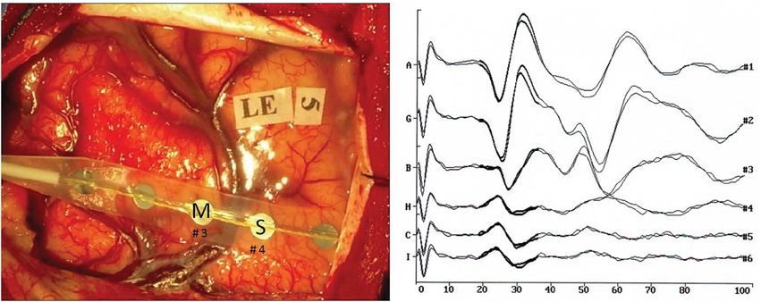
Localization of Sensorimotor Cortex
Band Pass: 1-30Hz to 250-1,500Hz (-3 dB)
Analysis Time Median: 50ms
Number of Averages: 25-50 repetitions (at least 2 trials)
Amplitude Range: 20-500uV

Slide 53
AED Medication

Slide 54
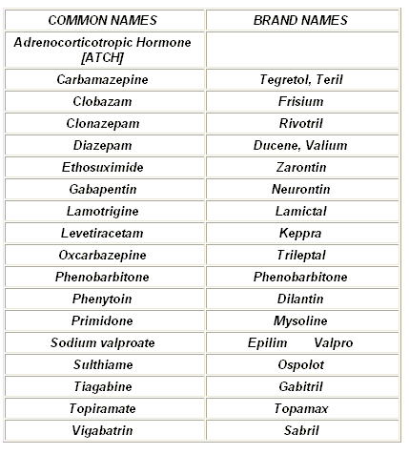
AED Medication
Know generics!!!

Slide 55
AED Medication
Know first line treatment options!!!
Absence Seizure
Infantile Spasms
Partial (Focal) Seizures
Generalized Seizures
Juvenile Myoclonic Epilepsy

Slide 56
AED Medication
ACTH
Adrenocorticotropic Hormone
Treats Infantile Spasms

Slide 57
Sleep & EEG

Slide 58
Sleep & EEG
Stage 1
Drowsiness/Light Sleep
Slow rolling eye movements
Vertex waves
Waxing and waning of PDR
Increased theta

Slide 59
Sleep & EEG
Stage 2
Sleep spindles (12-14 Hz)
K-complexes
Mixture of frequencies – predominately theta

Slide 60
Sleep & EEG
Stage 3
Slow wave sleep
Mentally restorative
20% or greater of the background is delta frequency
May see fast activity superimposed on delta waves

Slide 61
Sleep & EEG
REM Sleep
Physically restorative
Atonia
Very low or suppressed muscle tone
Sawtooth waves noted
Irregular respirations
Irregular heart rate
Rapid eye movements
Mixed frequencies

Slide 62
Sleep & EEG
Narcolepsy
Chronic sleep disorder causing excessive daytime drowsiness and sleep
Normal EEG
Sleep onset REM
Within 5 minutes of sleep
70-75% of people with Narcolepsy also have Cataplexy
Sudden and transient episode of muscle weakness accompanied by full conscious awareness, typically triggered by strong emotions such as crying, fear, laughing, etc.

Slide 63
Sleep & EEG
Cheyne-Stokes Respiration
Associated with Central Sleep Apnea
Abnormal pattern of breathing characterized by progressively deeper, faster breathing, followed by a gradual decrease that results in a temporary stop in breathing called an apnea
Pattern repeats, which each cycle taking 30 seconds to 2 minutes

Slide 64
Terms to Know

Slide 65
Anatomical Planes

Slide 66
BAER
Brainstem Auditory Evoked Response
May be used for an ECI recording
No response = No outcome value
Only wave 3 = Poor prognosis

Slide 67
Beneficence
States that researches should have the welfare of the research participant as a goal of any clinical trial or other research study
Medical Professionals are obligated to:
Weigh possible benefits vs. possible risks of an action
Prevent and remove harm in a situation

Slide 68
Kindling
Commonly used model for the development of seizures and epilepsy in which the duration and behavioral involvement of induced seizures increases after seizures are induced repeatedly
A seizure may increase the likelihood that more seizures will occur

Slide 69
Agnosia
The inability to process sensory information, typically with loss of ability to recognize objects, persons, shapes, smells or sounds.
Specific sense is not defective
No significant memory loss
Associated with brain injury or neurological illness
Stroke, dementia
Specifically to parietal and occipital lobes

Slide 70
Anosmia
The loss of sense of smell; inability to perceive odor or a lack of functioning olfaction
Can be caused by allergies, cold, nasal polyps, meningitis, neurosyphilis, brain injury affecting olfactory nerve, neurodegenerative diseases

Slide 71
Apraxia
Inability to execute a voluntary or purposeful motor movement despite being able to demonstrate normal muscle function
Cause by injury to the brain, specifically posterior parietal cortex

Slide 72
Ataxia
Lack of voluntary coordination of muscle movements that includes gait abnormality.
Related to dysfunction of the nervous system, specifically in the cerebellum

Slide 73
Locked-in Syndrome
Condition in which the person maintains consciousness/awareness, but the body and most of the facial muscles are paralyzed and the ability to perform certain eye movements is preserved
Caused by injury to the brainstem

Slide 74
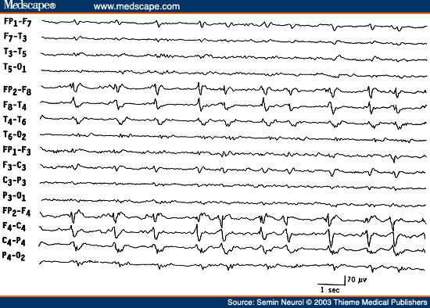
PLEDS
Periodic Lateralized Epileptiform Discharges
Updated ACNS terminology – LPDs (lateralized periodic discharges)
Clinical significance??
Stroke
Herpes Simplex
Encephalitis

Slide 75
BIPLEDS
Bilateral Independent Lateralized Epileptiform Discharges
Updated ACNS terminology – BIPDs (bilateral periodic discharges)
Clinical significance??
Hypoxic encephalopathy

Slide 76
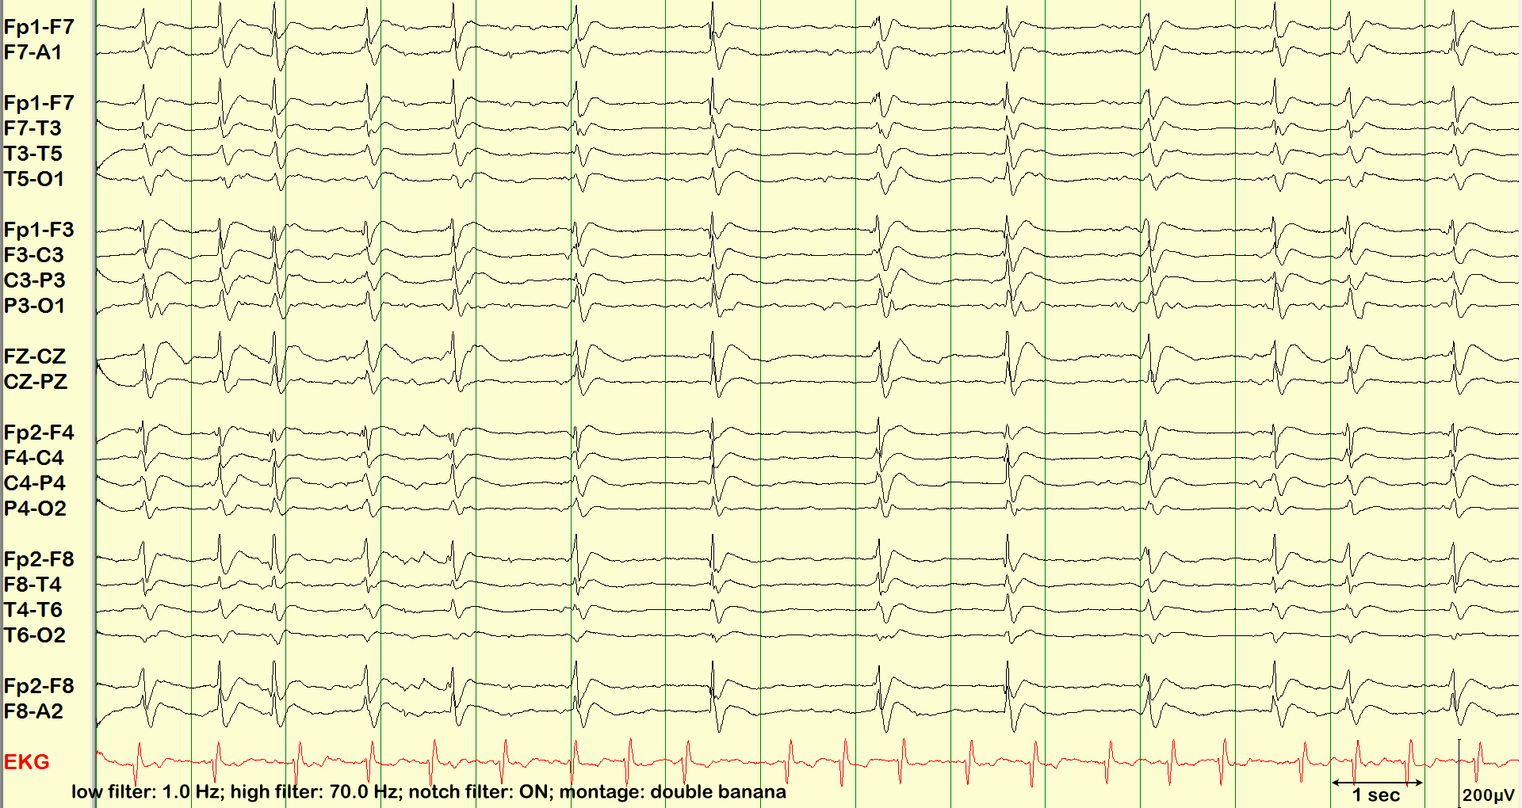
GPEDS
Generalized Periodic Epileptiform Discharges
Updated ACNS terminology – GPDs (generalized periodic discharges)
Clinical Significance?
Hypoxic Encephalopathy

Slide 77
FIRDA
Frontal Intermittent Rhythmic Delta Activity
Updated ACNS terminology – GRDA; frontally predominant (generalized rhythmic delta activity)
Clinical Significance?
Metabolic Encephalopathy

Slide 78
SIRPIDS
Stimulus Induced Rhythmic, Periodic or Ictal Discharges
Updated ACNS terminology – SI (stimulus induced)
Clinical significance??
Acute Brain Injury
Anoxic Insult

Slide 79
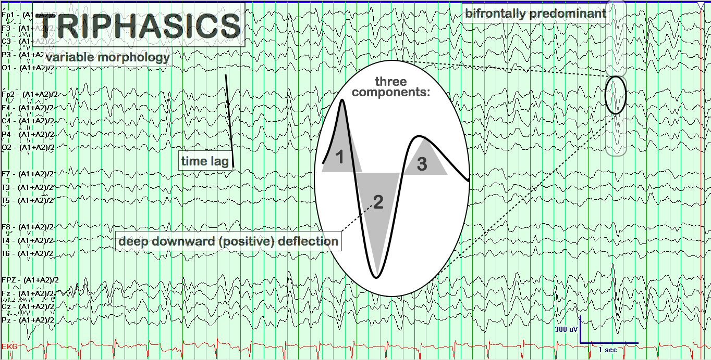
Triphasic Waves
Updated ACNS terminology – triphasic morphology
Clinical significance??
Metabolic Encephalopathy
Hepatic Encephalopathy
CJD

Slide 80
RAWOD
Regional Attenuation Without Delta
Clinical Significance?
Distinctive EEG pattern that can aid in the diagnosis and management of acute ischemic stroke (AIS)

Slide 81
RDA
Rhythmic Delta Activity

Slide 82
SUDEP
Sudden
Unexpected
Death in
Epilepsy

Slide 83
MELAS
Mitochondrial Encephalomyopathy, Lactic Acidosis, and Stroke-like Episodes
DNA mutation
Rare form of dementia
Seizures

Slide 84
ESES
Electrical Status Epilepticus of Sleep
What is this commonly associated with???
Notes:
Landau-Kleffner Syndrome

Slide 85
Rasmussen’s Encephalitis
Rare inflammatory neurological disease
Typically affects one hemisphere
Frequent and severe seizures
Loss of motor/speech skills
Hemiparesis

Slide 86
Mirror Focus
Secondary Epileptogenic Foci
Secondary spike focus in the contralateral hemisphere, transferred via corpus callosum
Slight delay between hemispheres

Slide 87
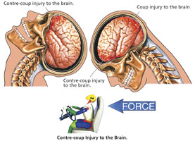
Coup and Contrecoup
Closed head injury
“Whiplash”

Slide 88
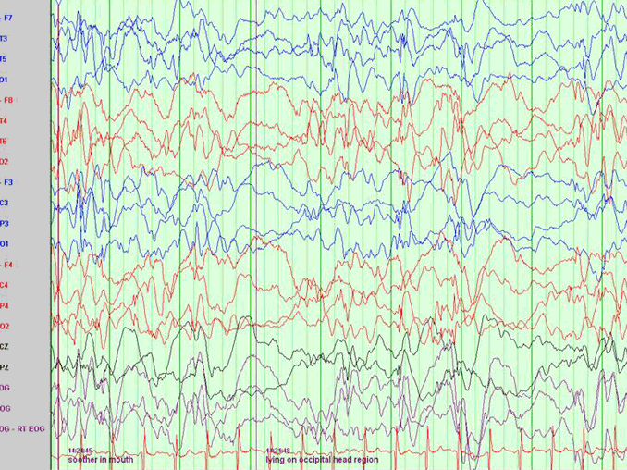
Hypsarrhythmia
Abnormal interictal pattern
High amplitude, multi-focal chaotic and disorganized EEG background

Slide 89
Todd’s Paralysis
Seizure is followed by a brief period of temporary paralysis
Typically occurs on one side of body
Partial or complete
Can last 30 minutes – 36 hours
Average is 15 hours
May affect speech and vision

Slide 90
Continuous EEG (cEEG) Monitoring in the ICU

Slide 91
cEEG in the ICU
Why is it important???

Slide 92
cEEG in the ICU
NCSE is unrecognized as the cause of unresponsiveness and coma in as many as 25-35% of hospitalized patients in the ICU setting

Slide 93
cEEG in the ICU
How long should patients be recorded?
24 hours, possibly longer if abnormal activity or seizure is observed.

Slide 94
Intracranial Pressure
Measured in millimeters of mercury (mmHg)
Typical range for a resting adult in supine position = 7-15 mmHg
20-25 mmHg = upper limit of normal
At this range, treatment to reduce ICP is needed
ICP Monitor – catheter inserted through the brain into the lateral ventricle, allowing CSF to drain
Sustained ICP > 28 mmHg correlates with burst suppression on EEG

Slide 95
Coma & EEG

Slide 97
Classified EEG Coma Grades
Grade 1 – Favorable outcome; normal sleep features with frontal monorhythmic delta activity
Grade 2 – Prognostically uncertain; nonreactive diffuse delta activity
Grade 3 – Poor outcome; low amplitude, diffuse, irregular delta
Grade 4 – Poor outcome; Burst suppression pattern, in particular when epileptiform discharges are seen with “low-output EEG”
Grade 5 – Fatal outcome; Isoelectric EEG or non-reactive alpha coma

Slide 98
CBF & EEG

Slide 99
Alpha Coma
Severe anoxic insult
Low voltage
Frontal distribution
Non-reactive to stimuli
Poor prognosis

Slide 100
Beta Coma
Overdose or excessive use of benzodiazepines or barbiturates
Fronto-central distribution
Typically non-reactive to stimuli
Generally good prognosis

Slide 101
Spindle Coma
Head injury, intracranial hemorrhage, anoxic insult
Interruption of ascending reticular activating influences at the ponto-mesencephalic junction
Brain remains in sleep like state
Delta waves with superimposed spindles
Intermittent or continuous
Fronto-central dominance
Reactive to stimuli
Typically good prognosis

Slide 102
Neonatal EEG

Slide 103
Neonatal EEG
Know these patterns:
Delta Brush
Trace Discontinue
Trace Alternat

Slide 104
Neonatal EEG
Duration of sleep-wake cycle =
60 minutes
Quiet and Active Sleep both present as early as 28 weeks

Slide 105
Neonatal EEG
Quiet Sleep
Comparable to Non-REM sleep
Irregular respirations
Rapid eye moments
Small and large body movements
Low muscle tone
Active Sleep
Comparable to REM sleep
No rapid eye movements
Minimal body movements
Increased muscle tone
Regular respirations

Slide 106
Neonatal EEG

Slide 107
Neonatal EEG

Slide 108
Helpful Hints
Know proper EEG terminology
Know the ACNS Guidelines for LTM
Make yourself a “cheat sheet” before you begin the exam
Read each question carefully
Read each answer carefully
Use process of elimination
Pick the BEST answer that fits the question

Slide 109
Questions??

Slide 110
Contact Information
Jennifer Vierkant, BS, R.EEG/EPT, CLTM, RPSGT
Minnesota Epilepsy Group
Director, END Services
jvierkant@mnepilepsy.net
D: 651-241-5376

