Slide 1
EMG Studies
…because, why not?
Andrew L. Reeves, M.D.
Neurology
Director of Medical Affairs
Galactic Overlord

Slide 2
Financial Conflict Disclosure
Sadly, I have no financial conflicts to report!
HOWEVER, I am entirely open to financial conflicts. If you would like to create one for me, I prefer unmarked bills but will accept gold bullion, Bit Coin, or any other form of payment which is hard to track.

Slide 3
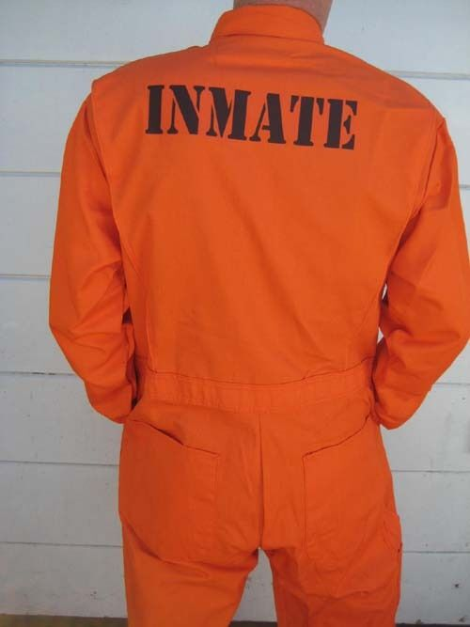
I Do Not Look Good…

Slide 4
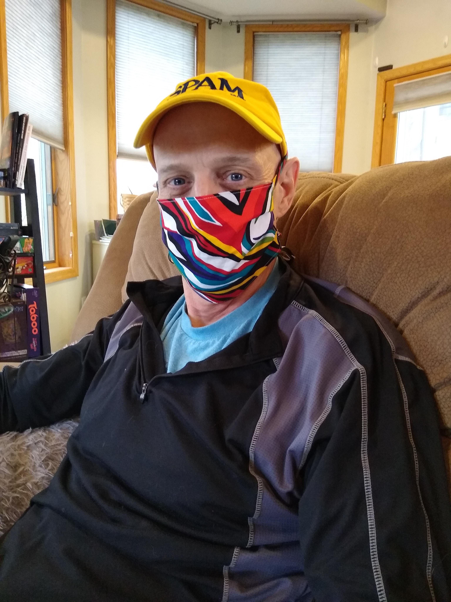
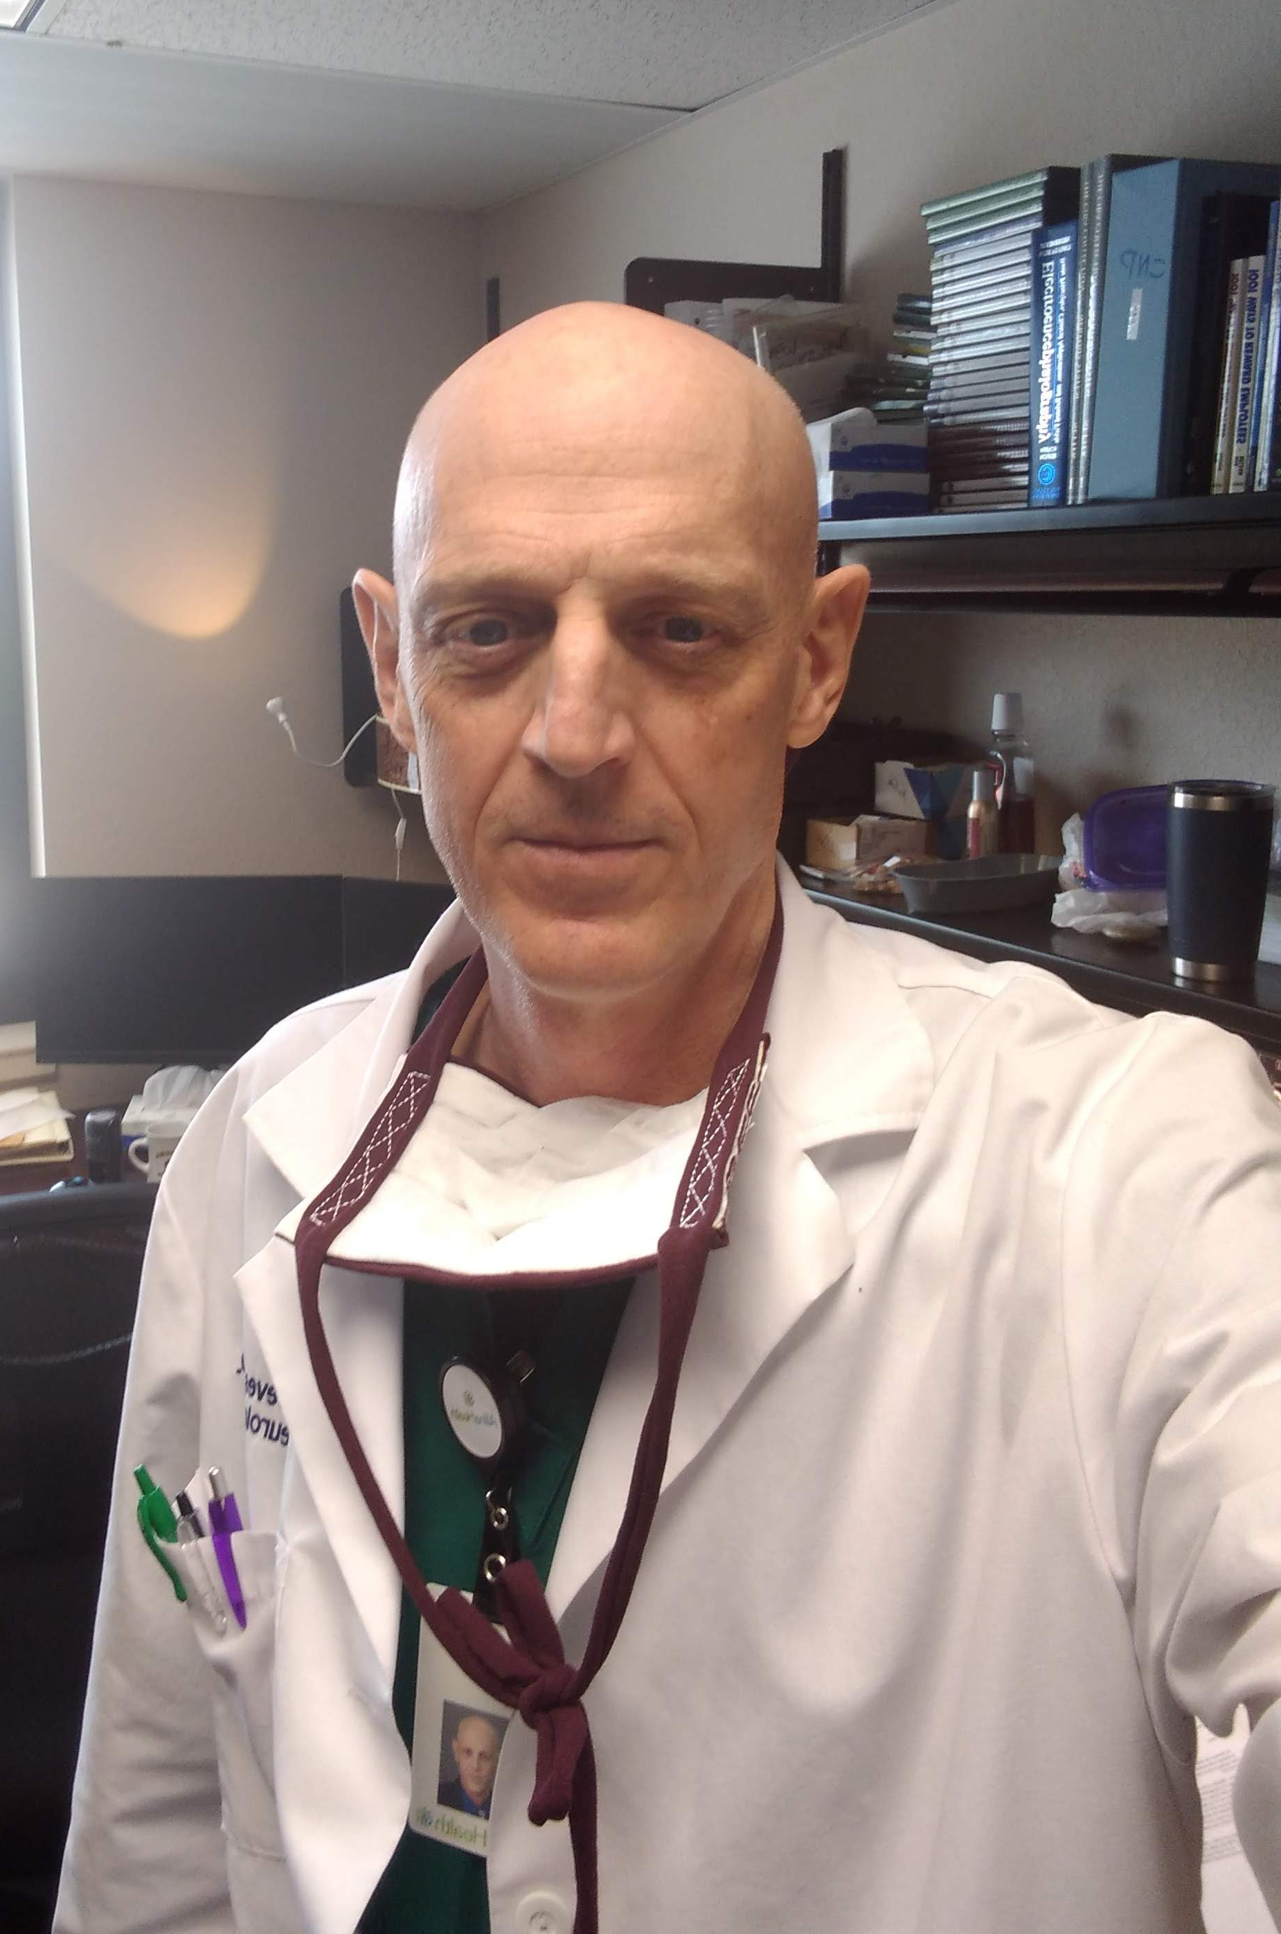
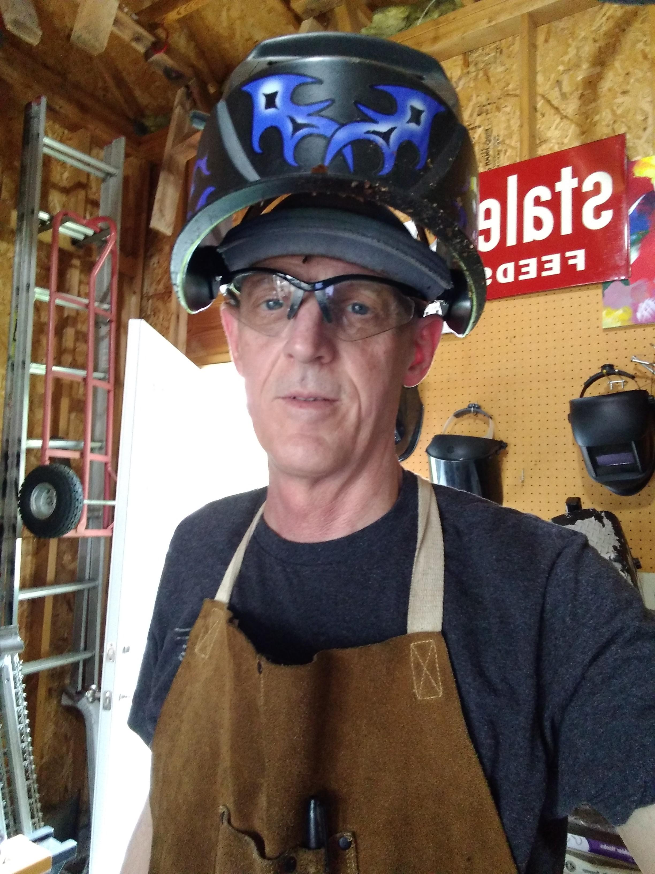
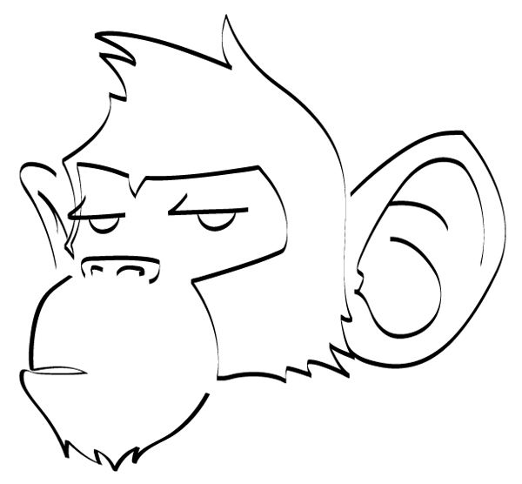
Who is this guy???!
Neurologist
Do a lot of neurophysiology
  About 600 studies per year
  EEG lab
  Autonomics lab

Slide 5
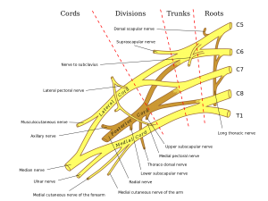
Today’s Plan
Introduction to EMG
Discuss some problems for which EMG is useful
Review some cases where EMG has some utility
We WON’T…
Review neuroanatomy or variants
Cover unusual situations
Dive into electronics

Slide 6
EMG: Two Main Things

Slide 7
A Little Terminology
Nerve Conduction Studies
Needle Examination

Slide 8
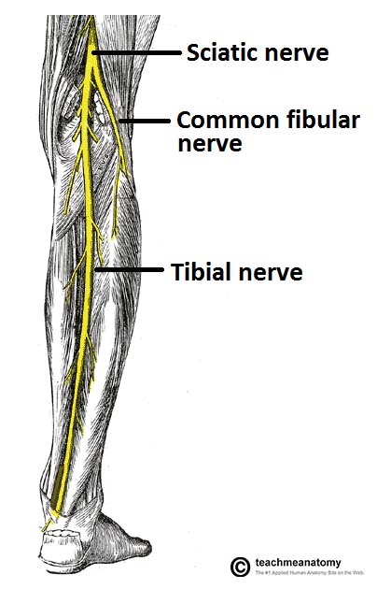
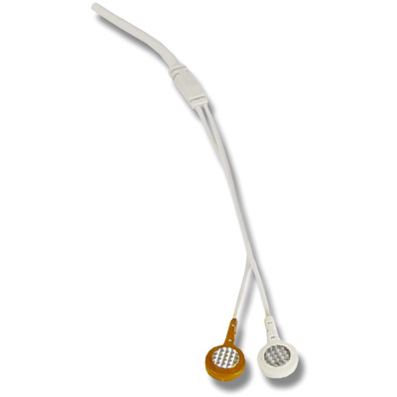
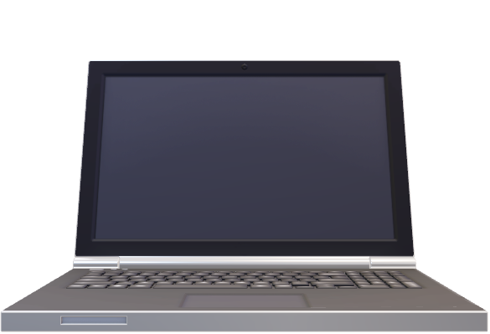
Shock a nerve, record “downstream”

Slide 9
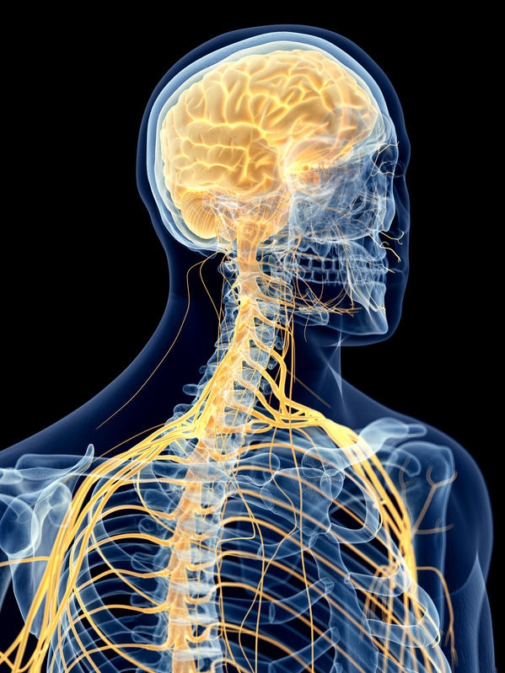
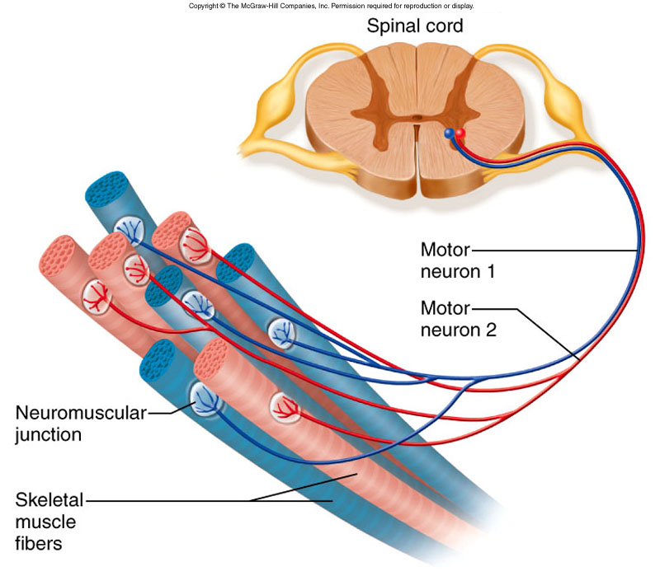

Slide 10
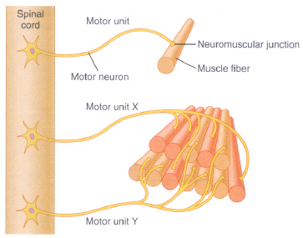
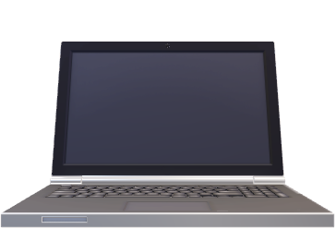
Stick a recording electrode into muscle

Slide 11
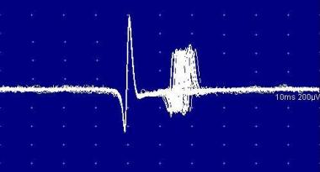
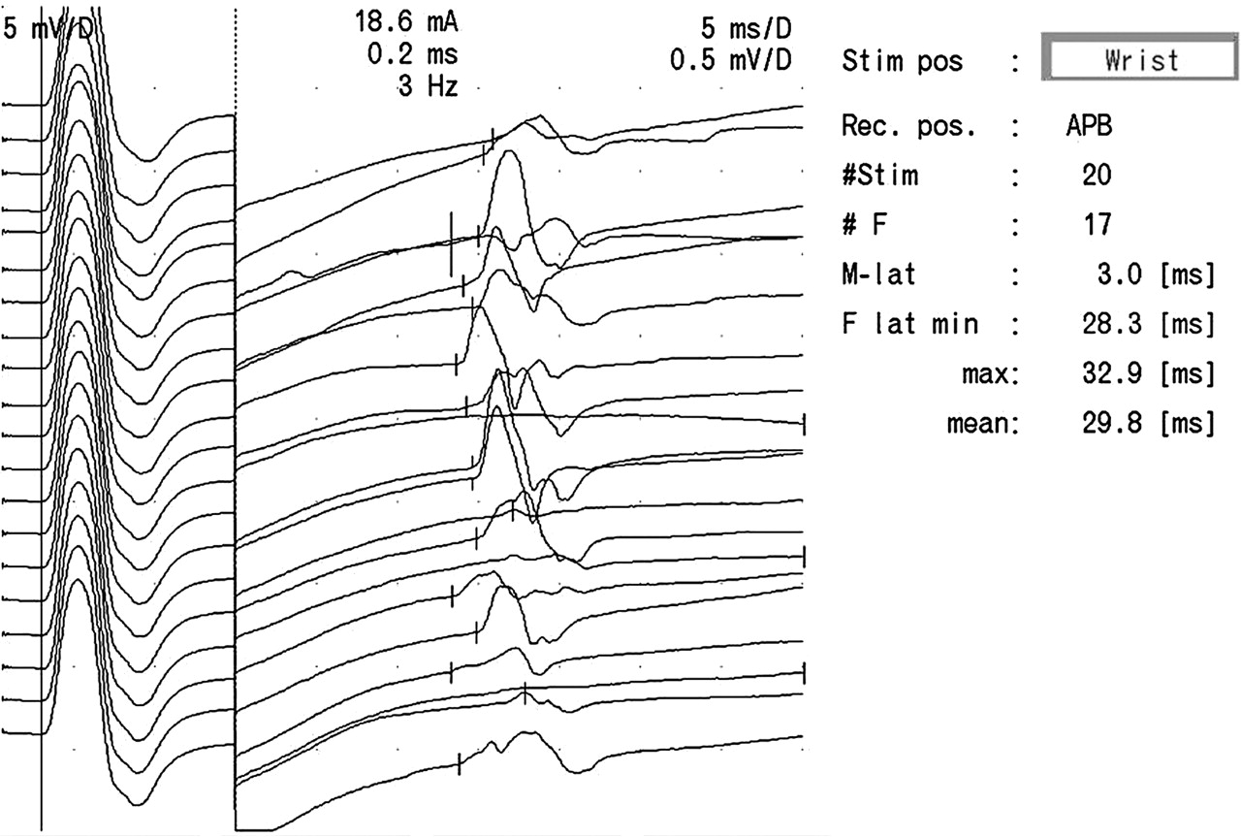
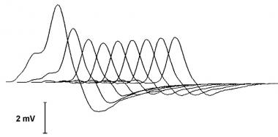
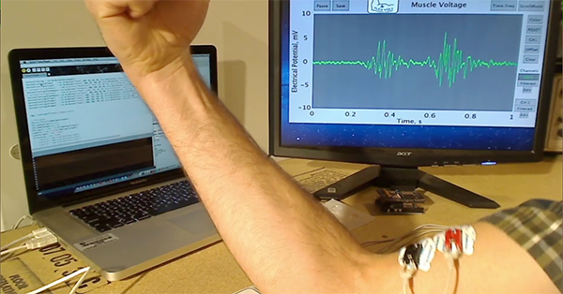
Gimme a Break!
All of EMG in three slides?!
It’s too simple,
I know!

Slide 12
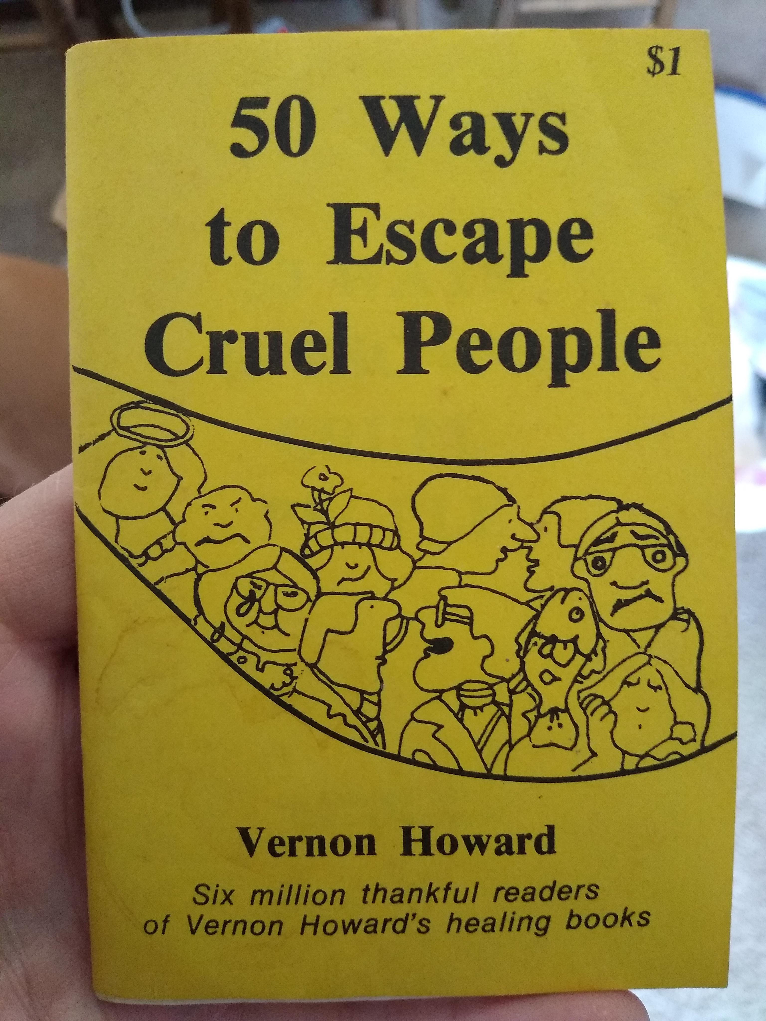
Further Reading…
https://www.amazon.com/50-Ways-Escape-Cruel-People/dp/0911203095

Slide 13
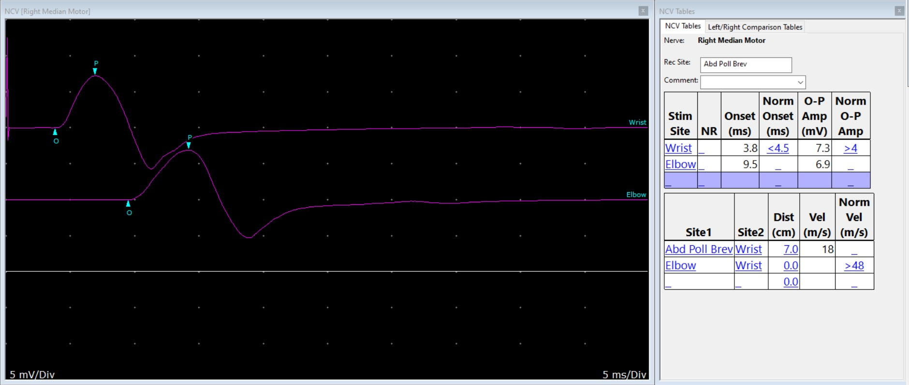

Slide 14
Case 1
47 yo right-handed line supervisor. Hx LBP, borderline diabetes
~12 months both hands tingling, now a bit more “dead numb.” Sometimes worse at night, sometimes during the day, too.
“Whole hand”
No particular injury

Slide 15
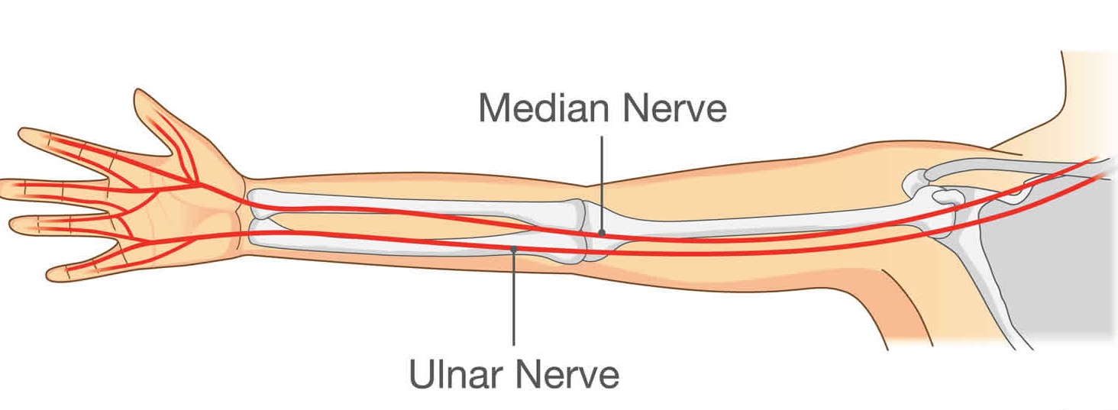
Anatomy Refresher

Slide 16
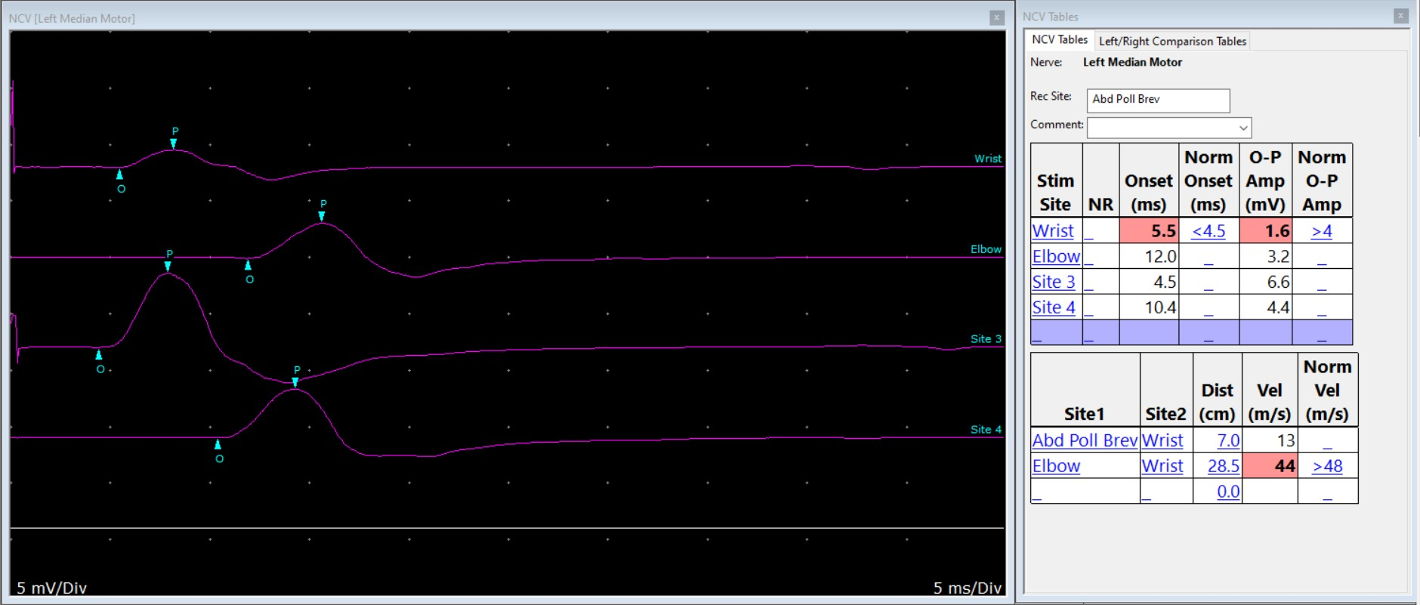
Left
DL
Median Motor
Ulnar Motor

Slide 17
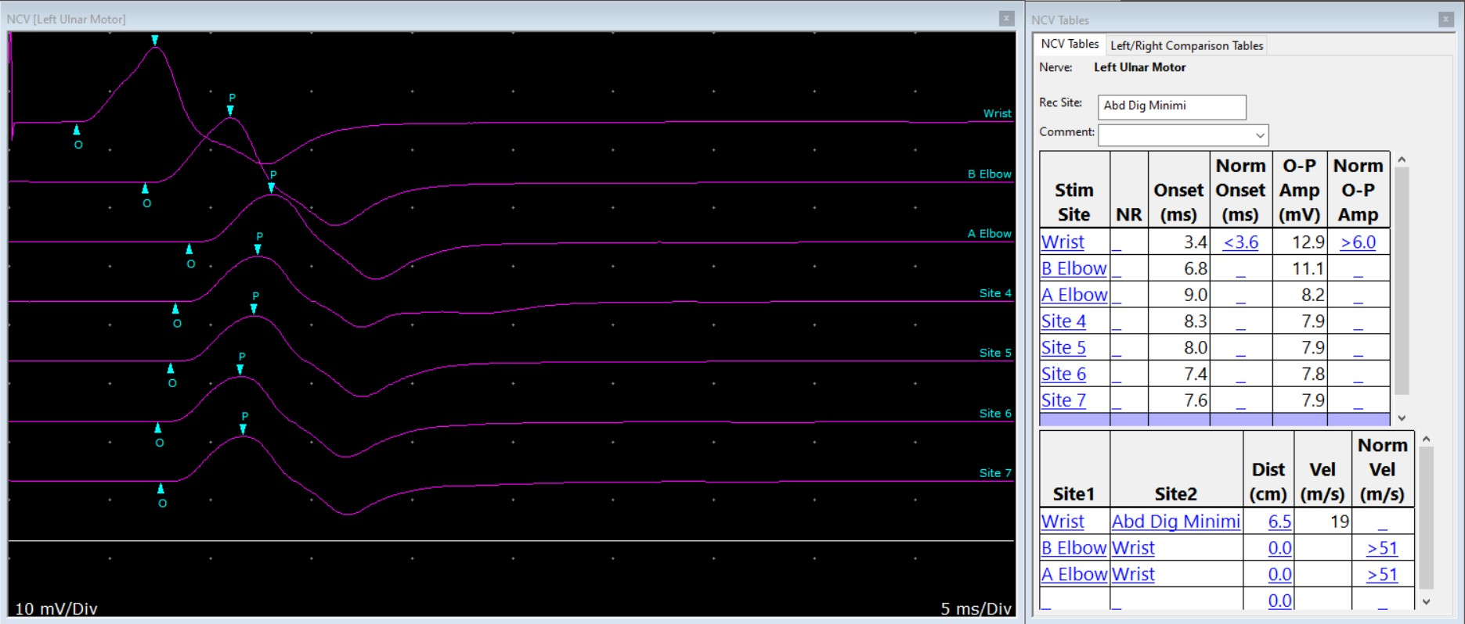
Left
Ulnar Motor
W
AE

Slide 18
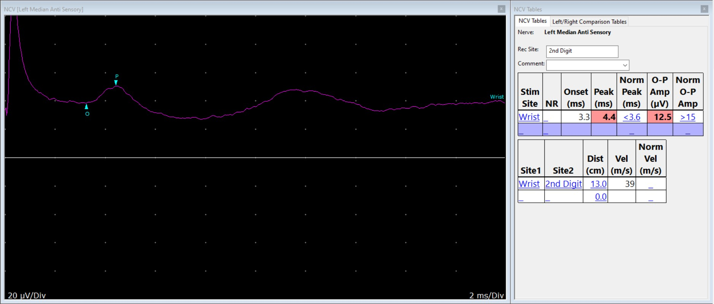
Left
Median Sensory

Slide 19
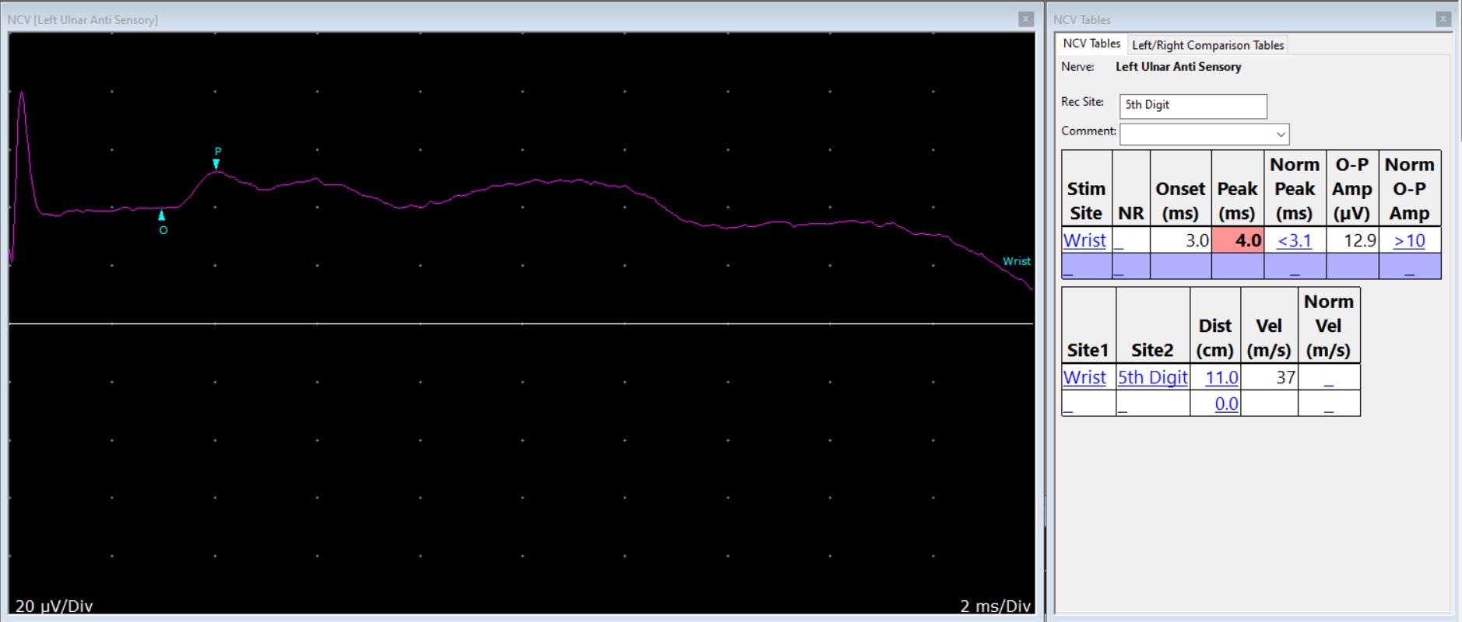
Left
Ulnar Sensory

Slide 20
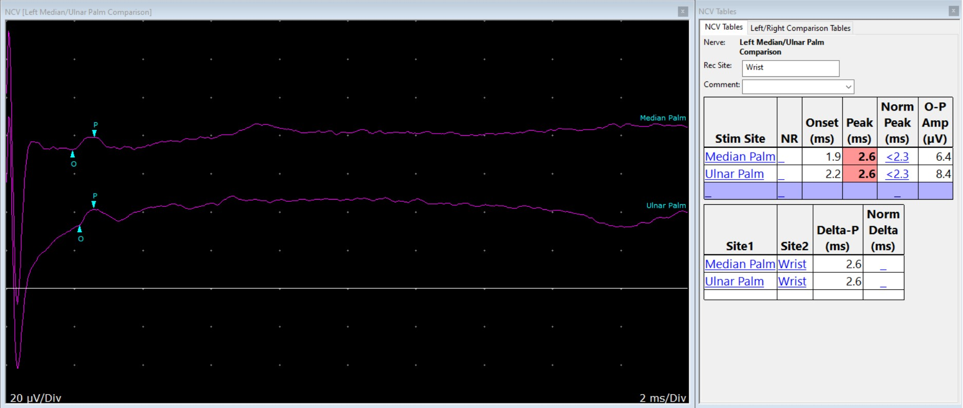
Left
M/U Palm Sensory

Slide 21
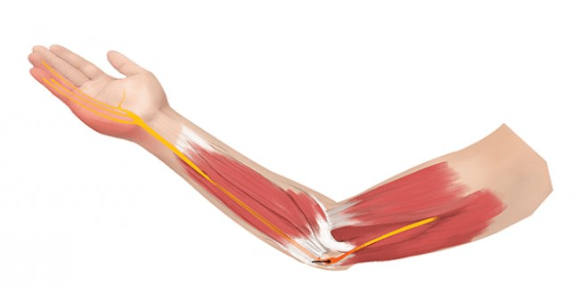

Slide 22
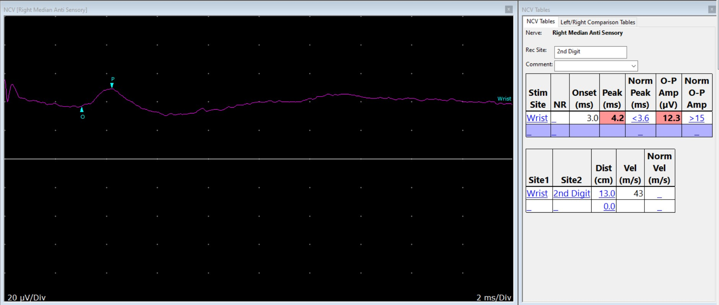
Right
Median Sensory

Slide 23
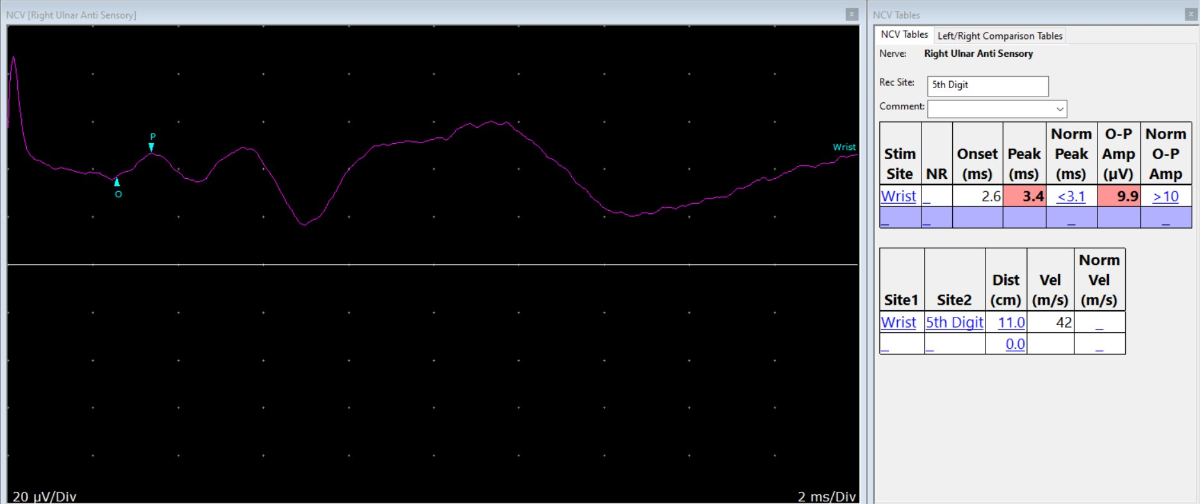
Right
Right Ulnar Sensory

Slide 24
Right
Median Motor

Slide 25
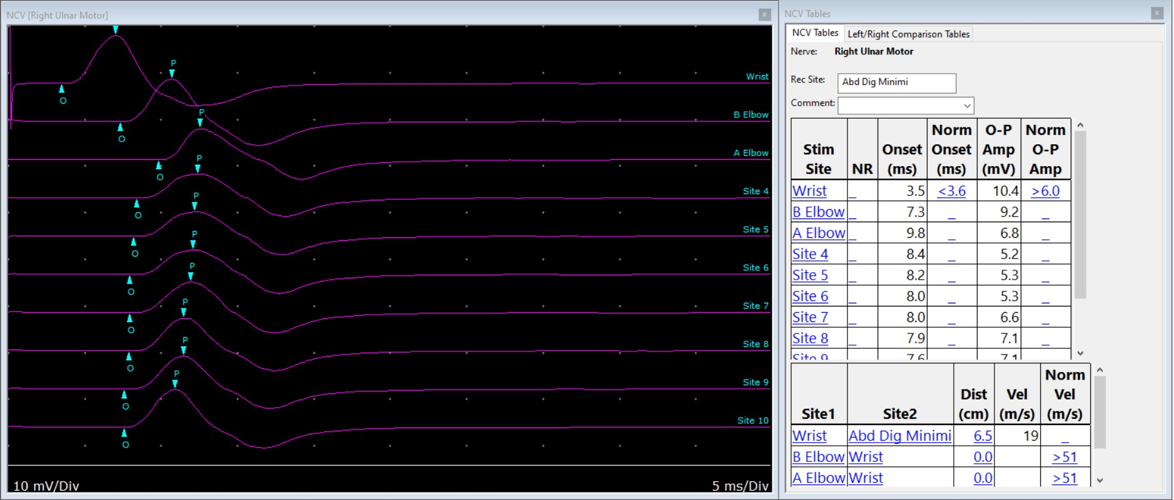
Right
Ulnar Motor

Slide 26
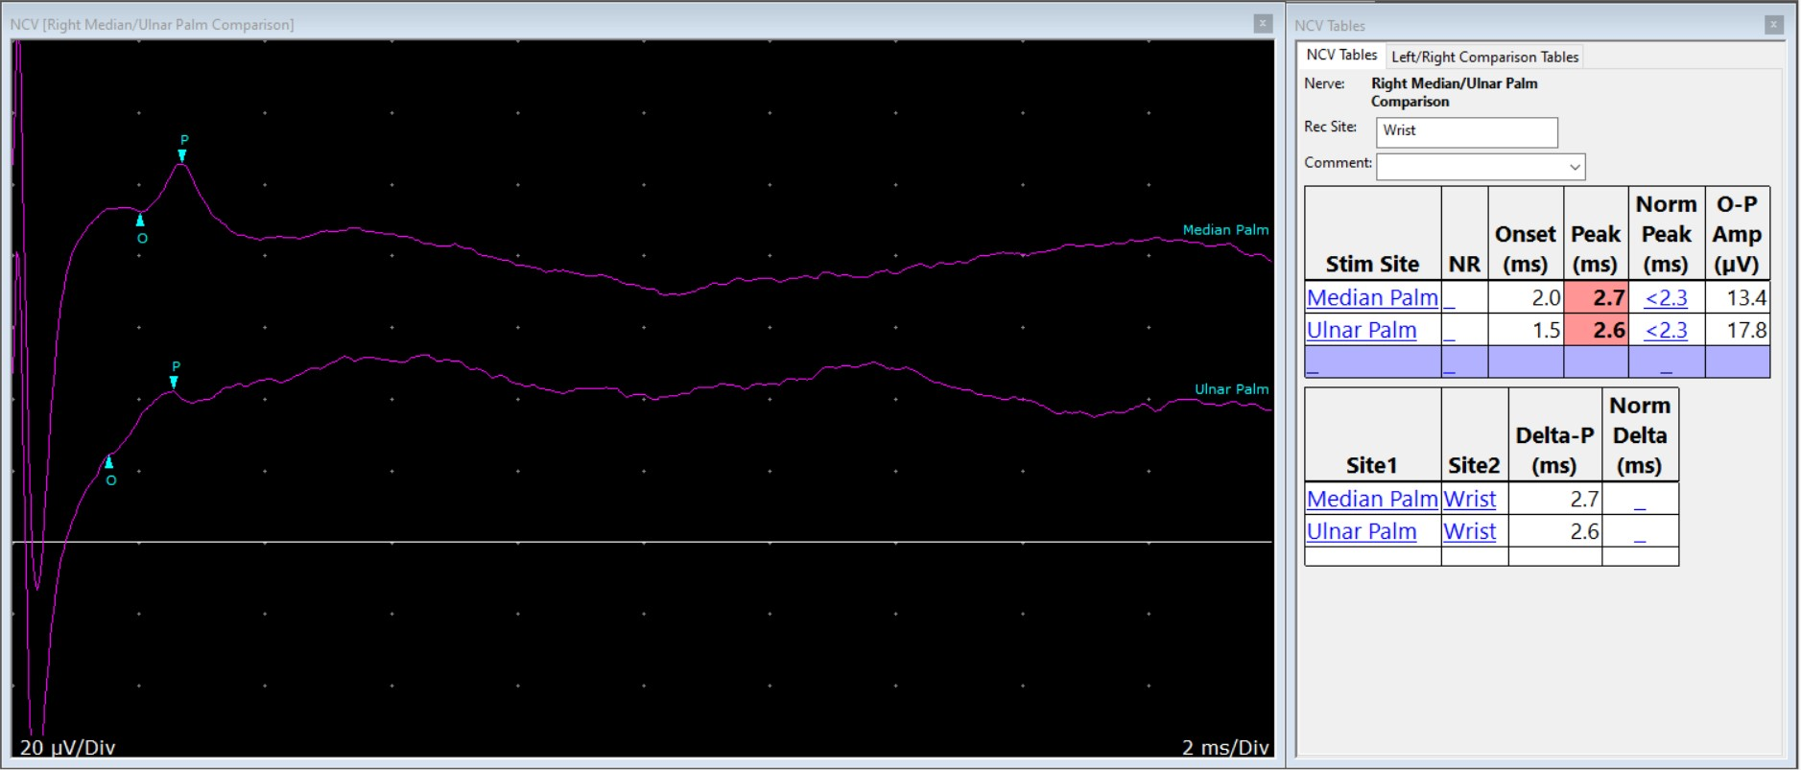
M/U Palm Sensory

Slide 27
Stick a recording electrode into muscle

Slide 28
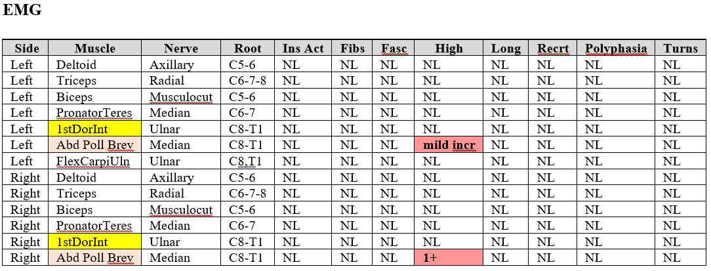
Needle Exam Findings…

Slide 29
Findings…
Ulnar neuropathy at elbow
  Left and right
Ulnar neuropathy at wrist
  Left and right
Median neuropathy at wrist (CTS)
  Left and right

Slide 30
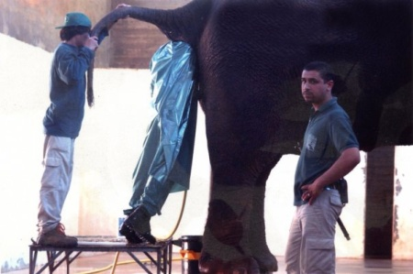
It’s a Tough Job Poking People…
Not as hard as…

Slide 31
Case 2
31 y.o. right-handed
Pain and numbness, left hand and forearm. Sometimes shoulder.
5 weeks
Weight: 470 lbs.

Slide 32
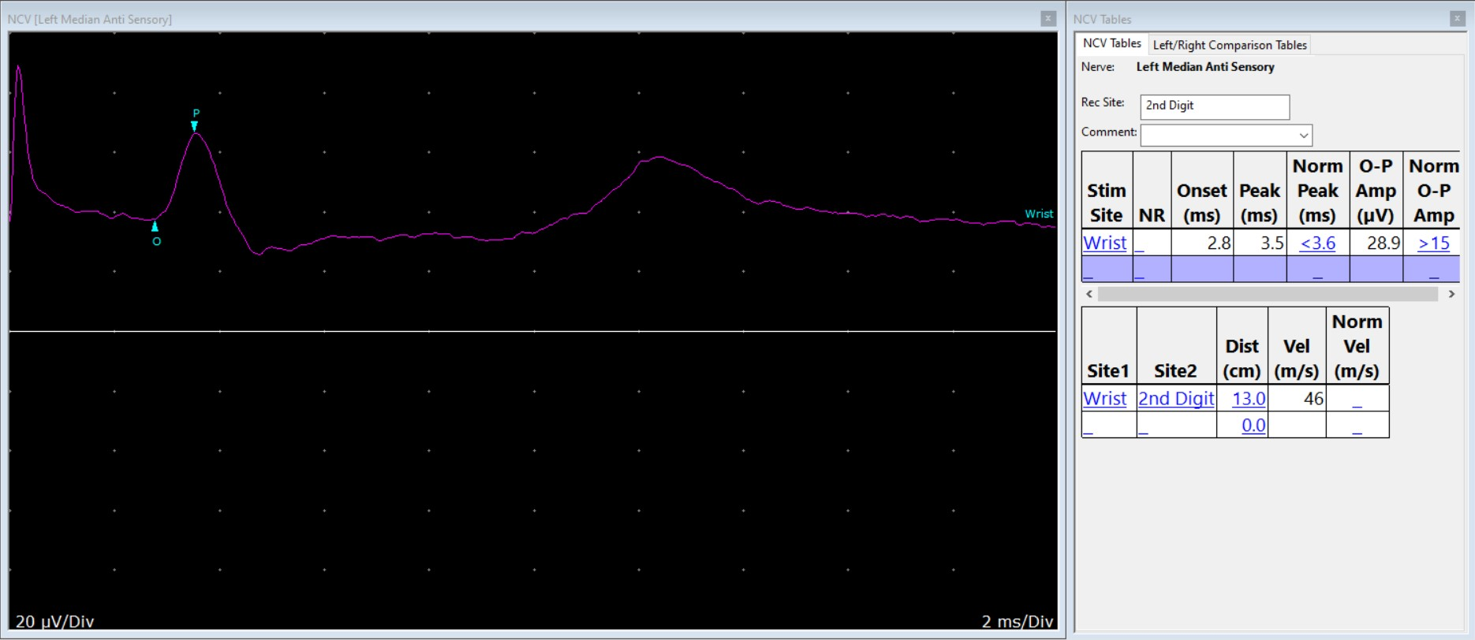
Median Sensory
Left hand

Slide 33
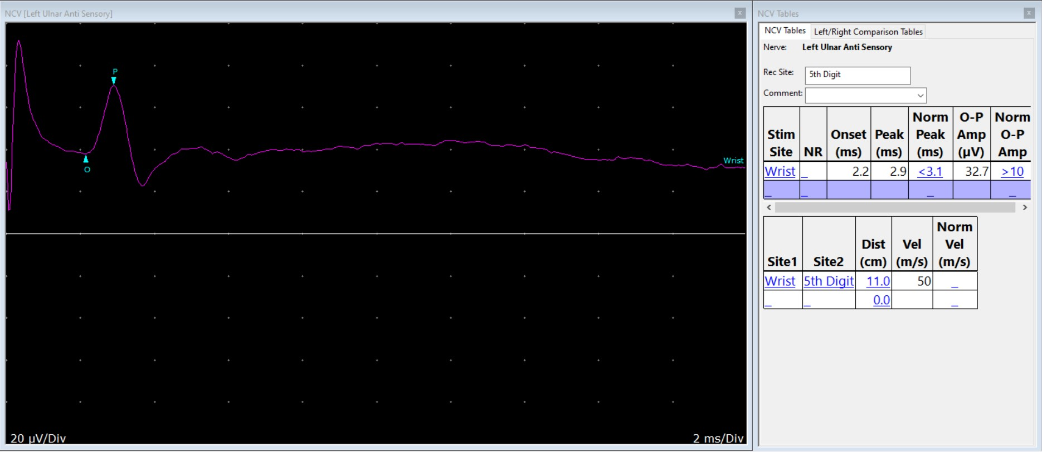
Ulnar Sensory
Left hand

Slide 34
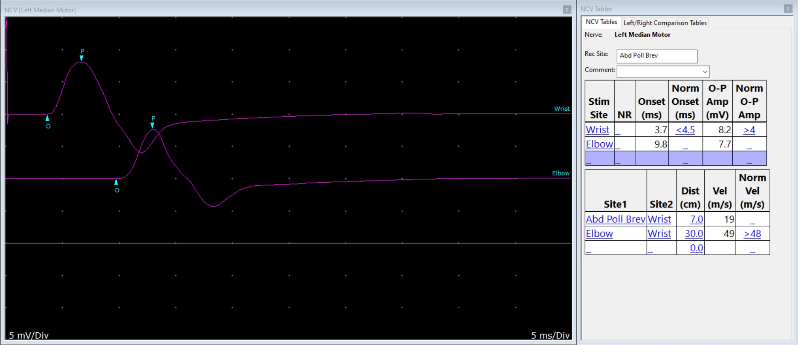
Median Motor
Left hand

Slide 35
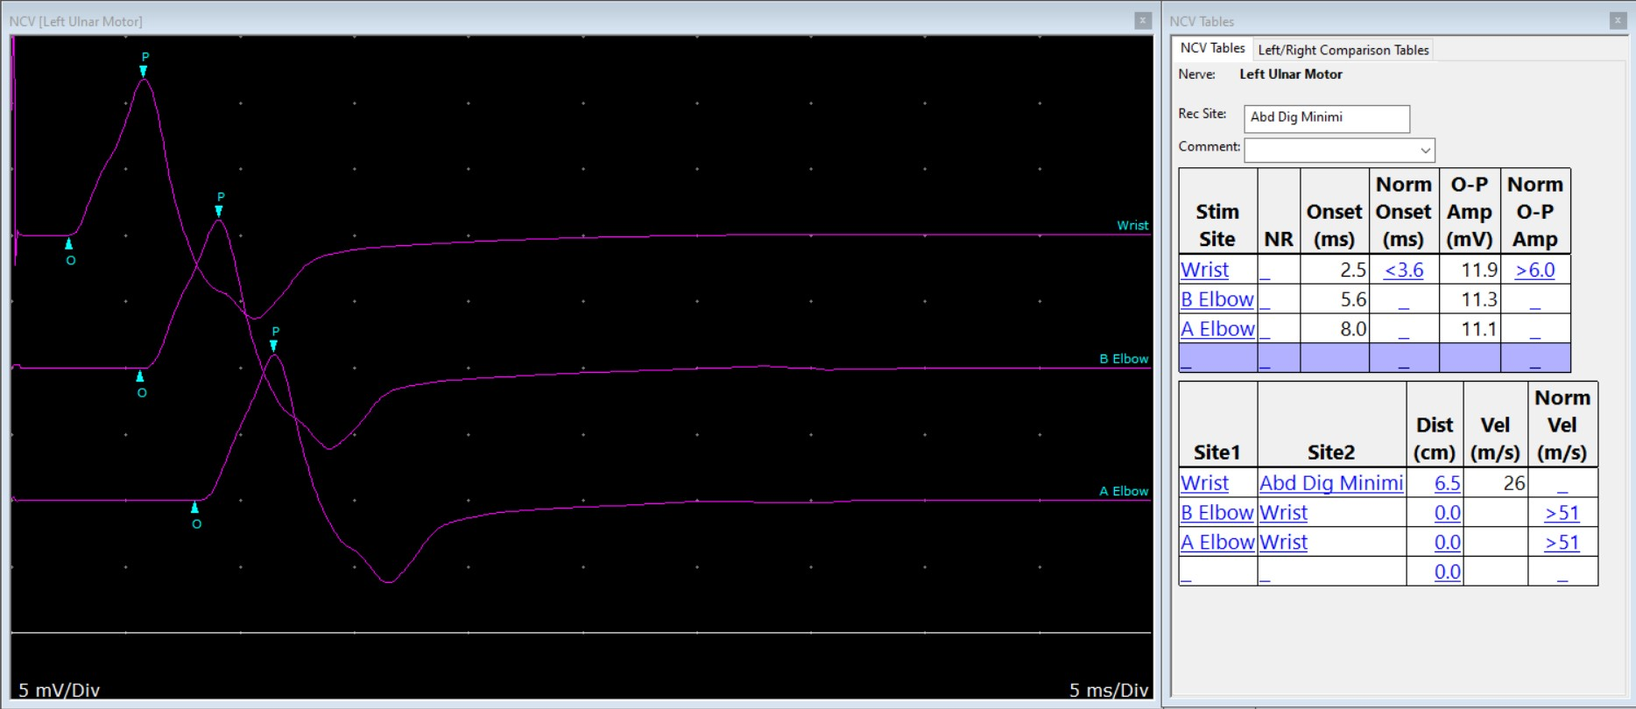
Ulnar Motor
Left hand

Slide 36
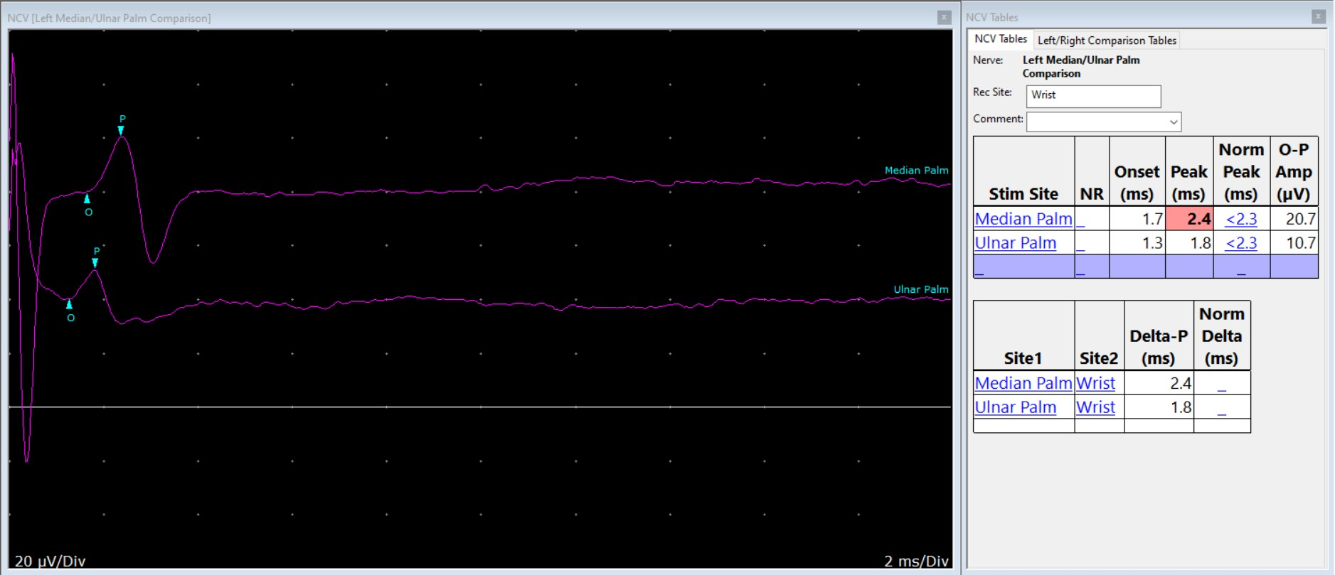
Median Palm Sensory
Ulnar Palm Sensory
Left hand

Slide 37

Median Sensory
Right hand

Slide 38
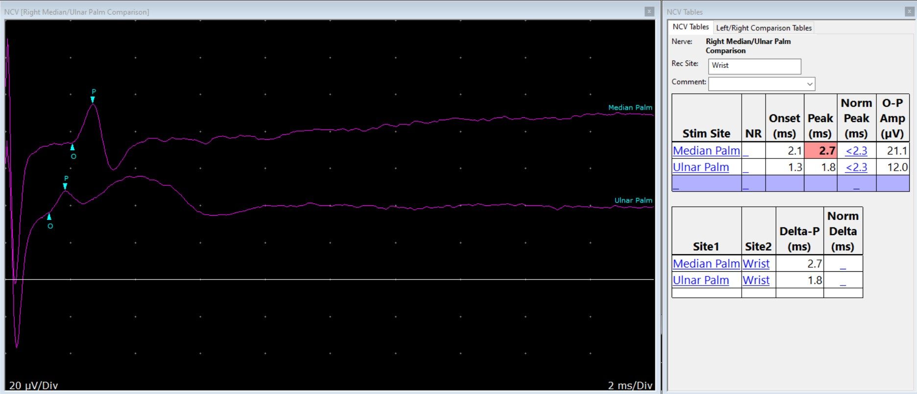
Median Palm Sensory
Ulnar Palm Sensory
Right hand

Slide 39
“Ya got a little of the carpal tunnel!”

Slide 40
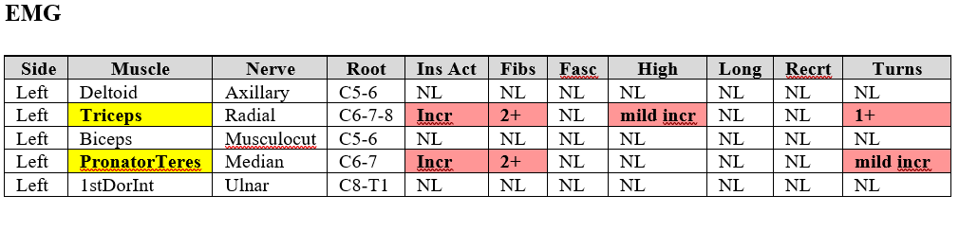
Needle Examination

Slide 41
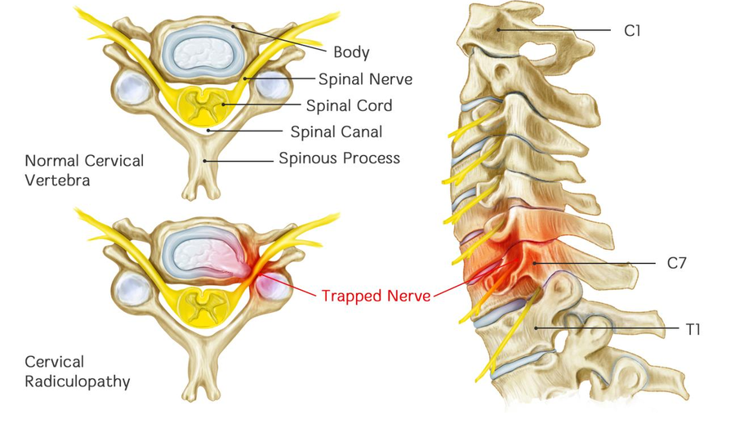

Slide 42
Case 3
52 y.o. woman.
Hx of HTN, obesity
On and off burning in feet for 1+ yr.
Increasing, now constant.
Worse at night

Slide 43
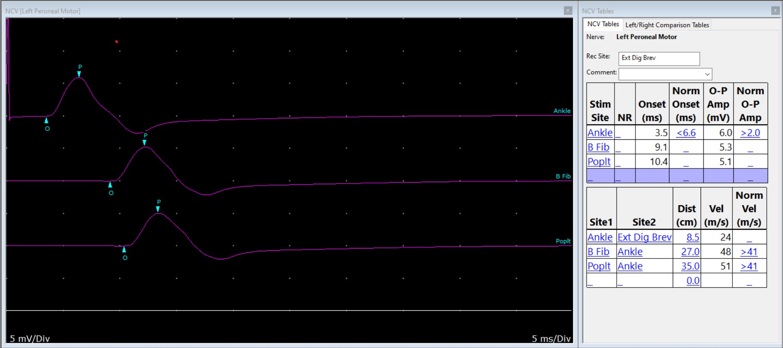

Slide 44
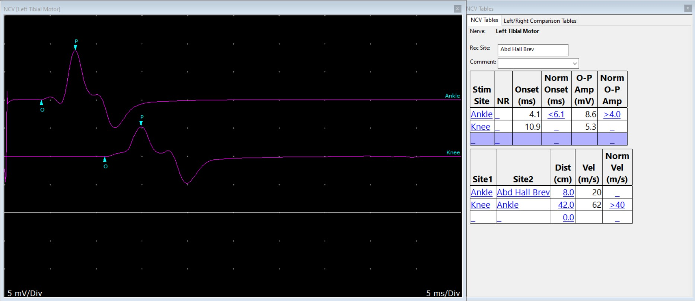

Slide 45
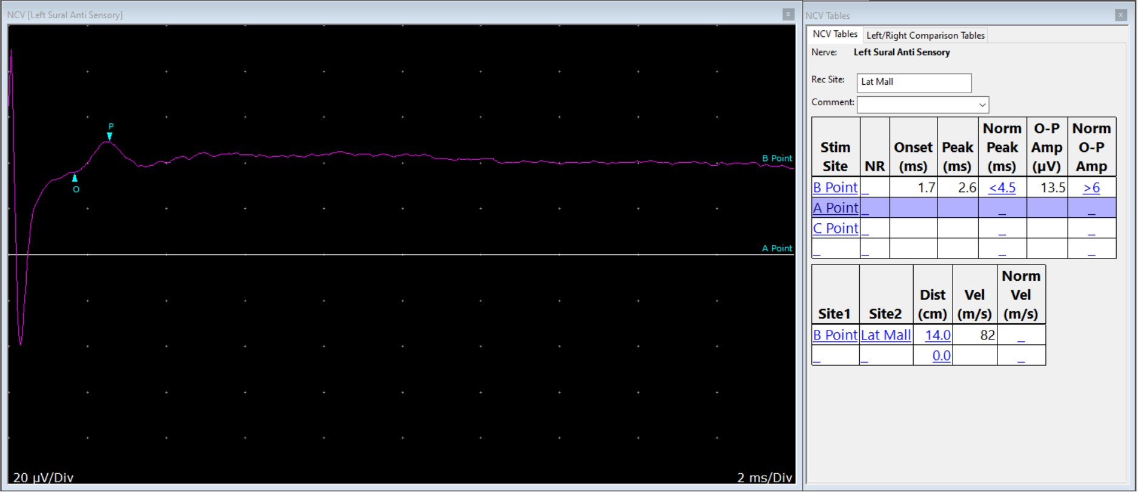

Slide 46
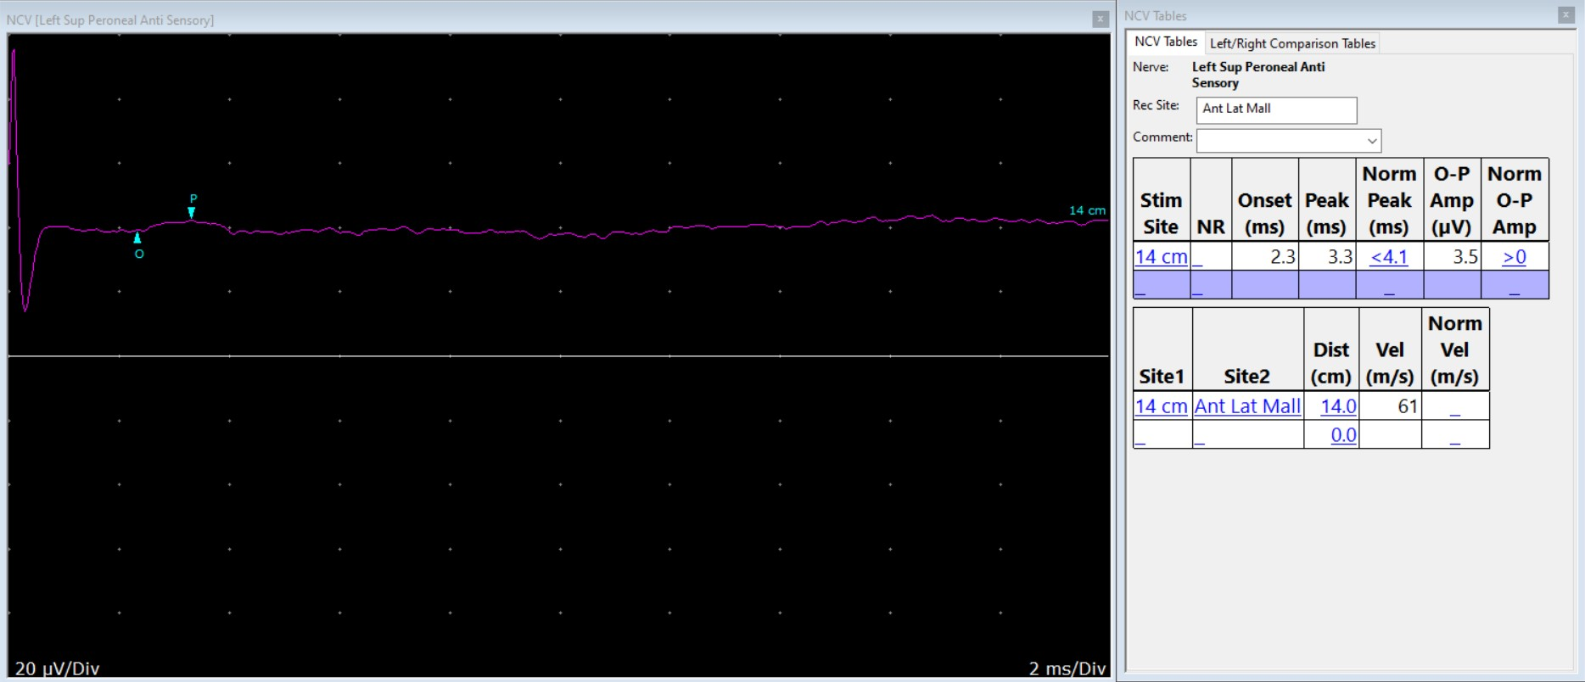

Slide 47
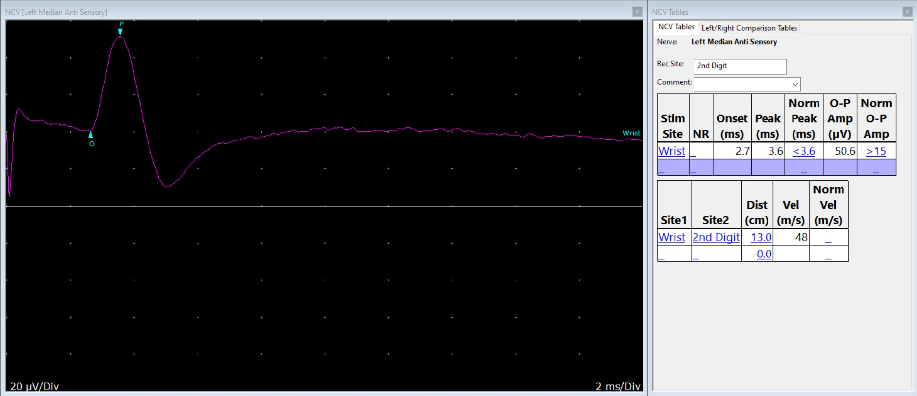

Slide 48
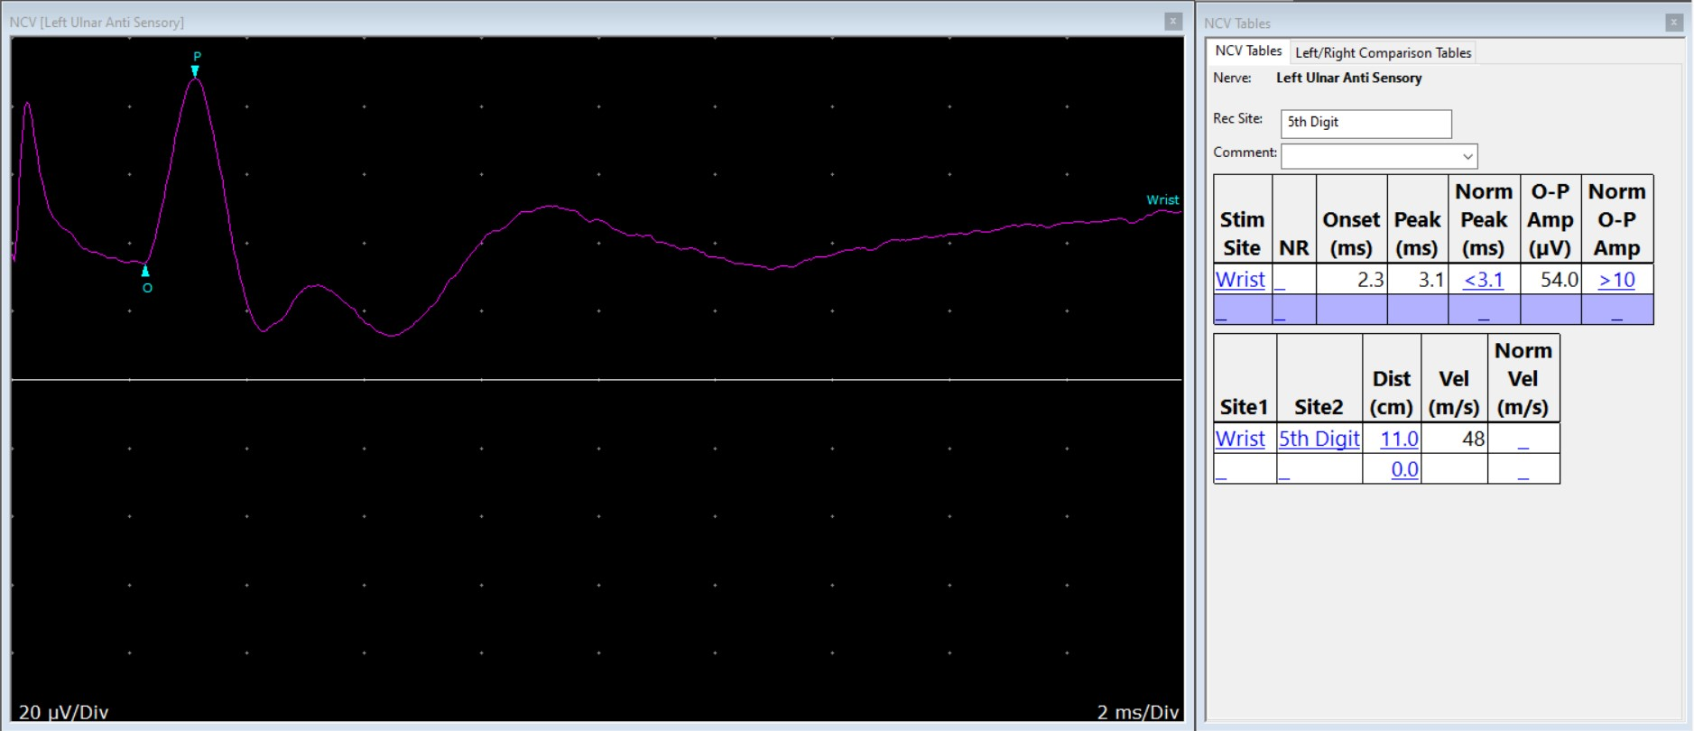

Slide 49
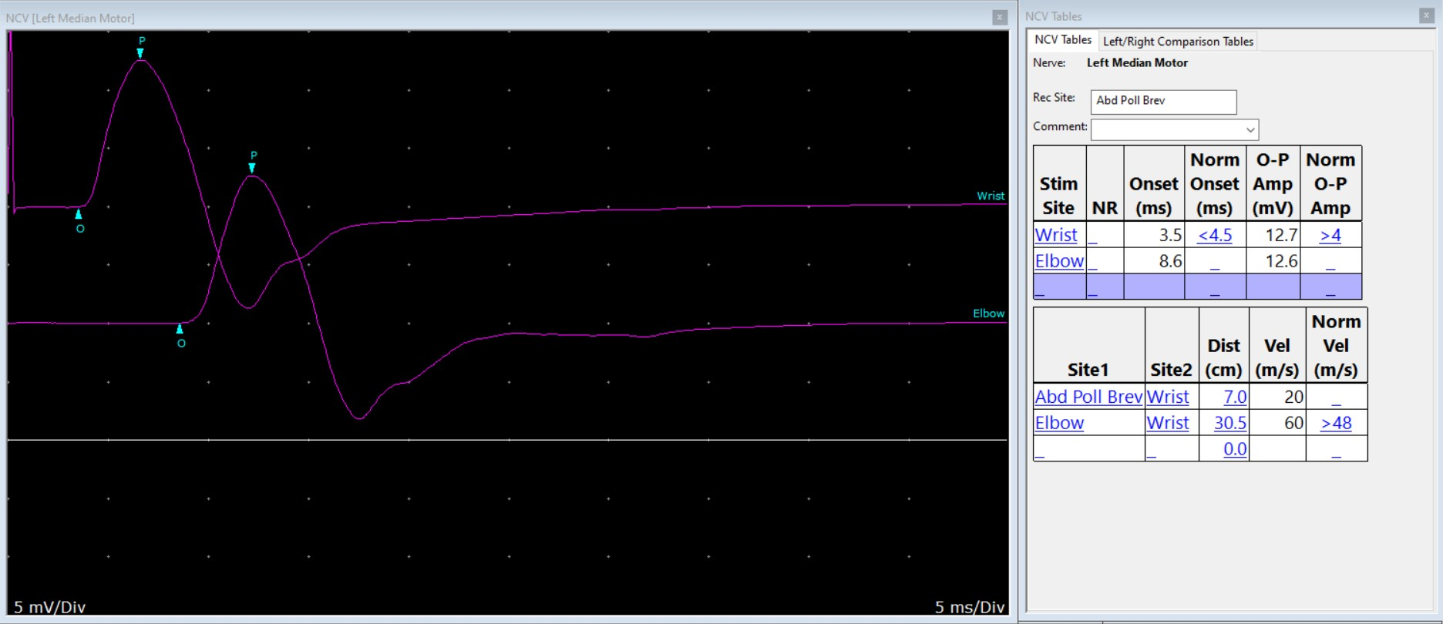

Slide 50
Stick a recording electrode into muscle

Slide 51
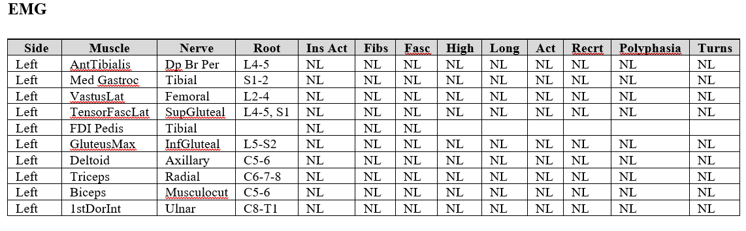

Slide 52
Not Very Satisfying…
Normal NCS
Normal needle exam
What gives??

Slide 53
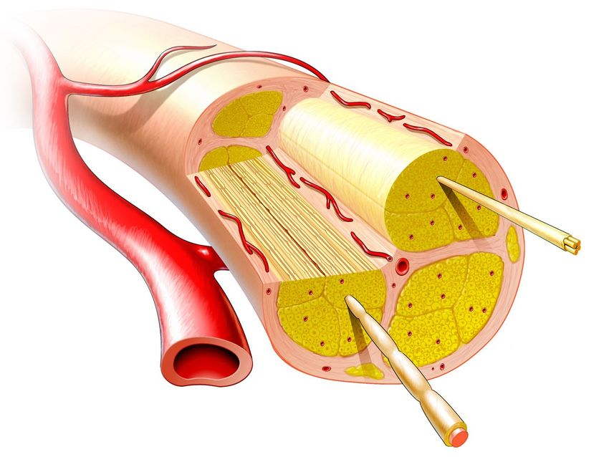

Slide 54
Limitations
EMG is a large fiber test
  Motor
  Sensory…if the patient has…
    Vibration
    Light touch
    Joint position (proprioception)
Small fiber problems – hardly rare
  Burning, aching, cold, prickling…

Slide 55
Best For….
Localized injury to nerves, such as
  CTS
  Disc pushing on a spinal nerve
Ok for generalized things damaging nerves
  Peripheral large fiber neuropathy
Certain muscle diseases (uncommon)

Slide 56
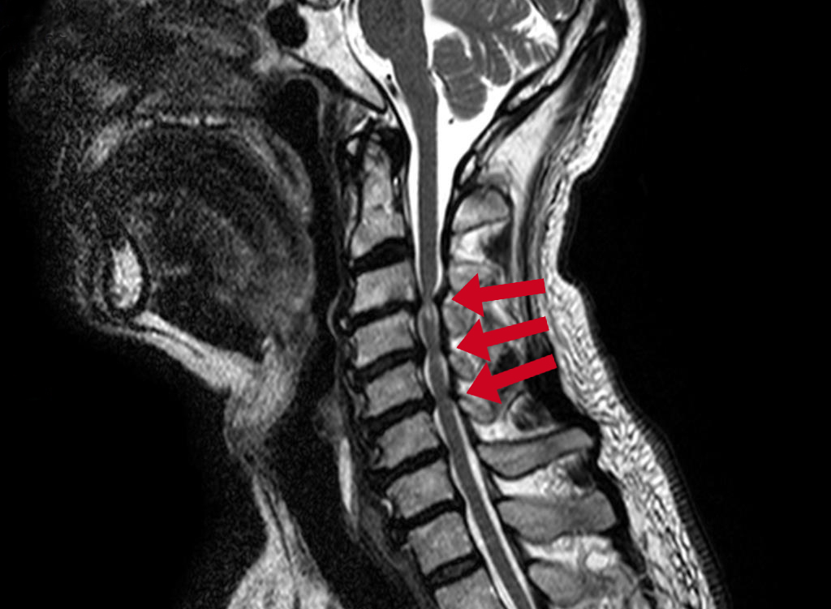
Since We’re On The Subject…
Spinal cord problems

Slide 57


Tiny Nerves

Slide 58
What Did We Learn In School Today?
NCS and Needle Exam
  “shockin’ and pokin’ people for fun & profit”
NCS reveal localized slowing (also generalized) in motor and/or sensory nerves
Large fiber only
NE reveals damage to motor axons and/or the muscle cells they innervate
  Work backwards to localize the problem
A number of nerve problems EMG doesn’t find

Slide 59

By Now…

Slide 60

So…It’s Time To…

