Slide 1
NDT Board Prep
Petra Davidson, BS, R. EEG/EP T., CLTM, FASET

Slide 2
Board Prep
Biggest shortcomings for most techs
Don’t know where to start
Don’t know how to study
Don’t know how to take a Board exam
Solutions
Start with the handbook & successful techs
Search study tips & find what works for you
Search board exam tips & find what works for you

Slide 3
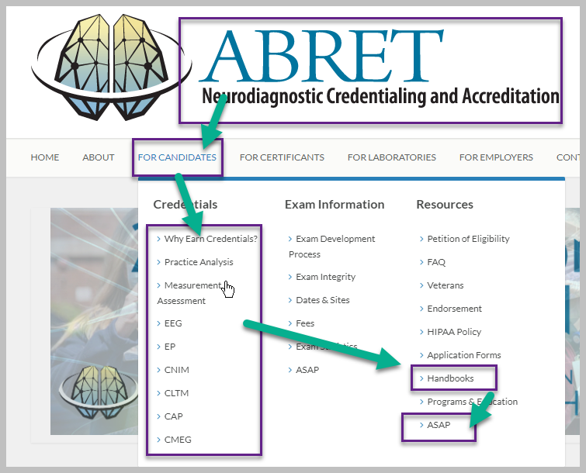
Step 1

Slide 4
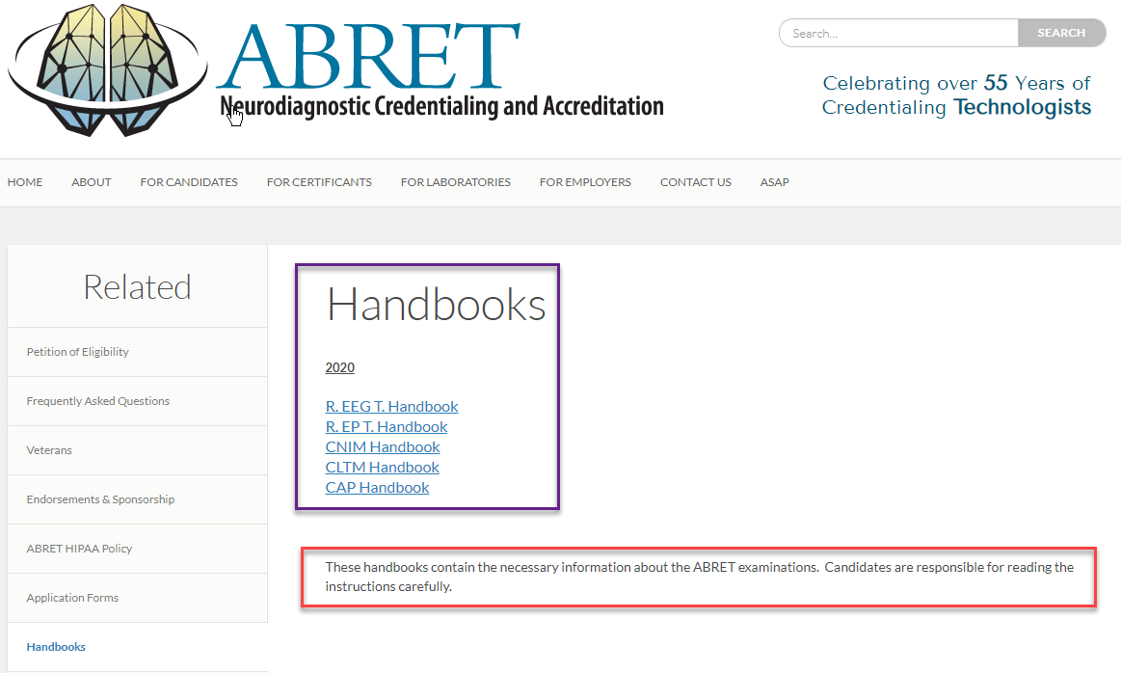
Step 2

Slide 5
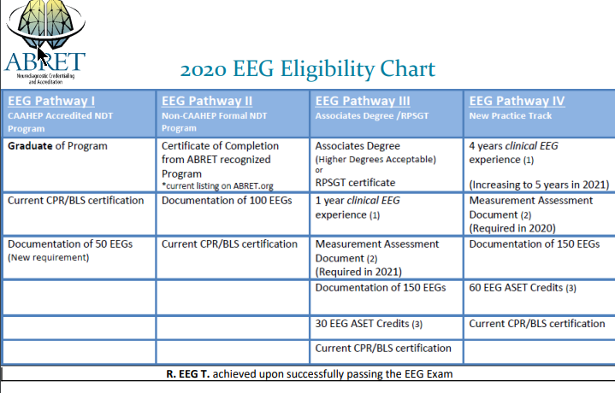
Step 3

Slide 6
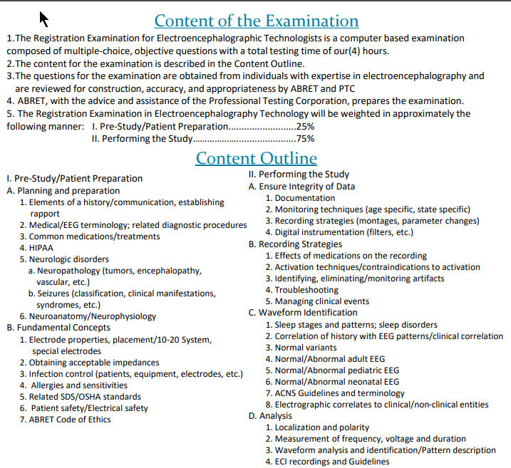
Step 4

Slide 7
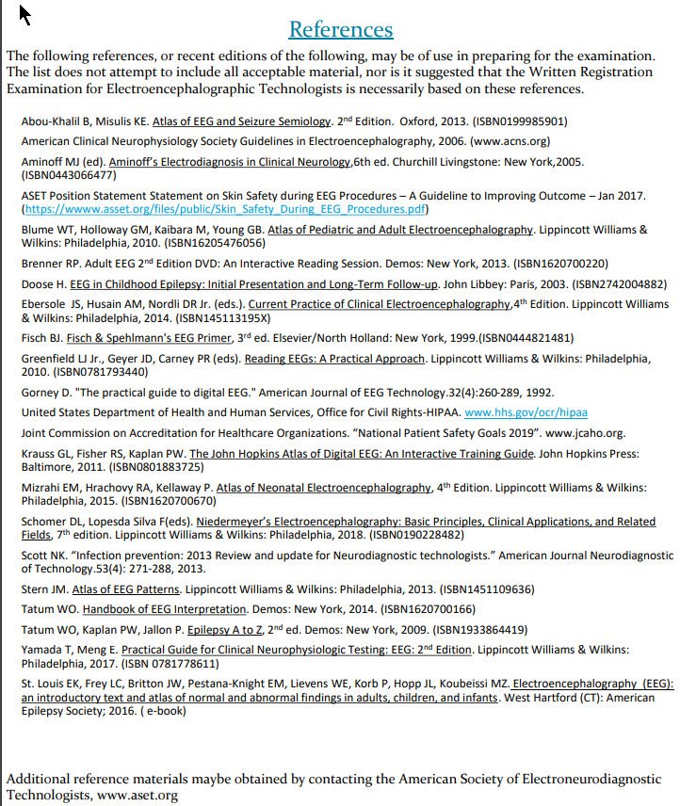
Step 5

Slide 8
Step 6
Collect resources

Slide 9
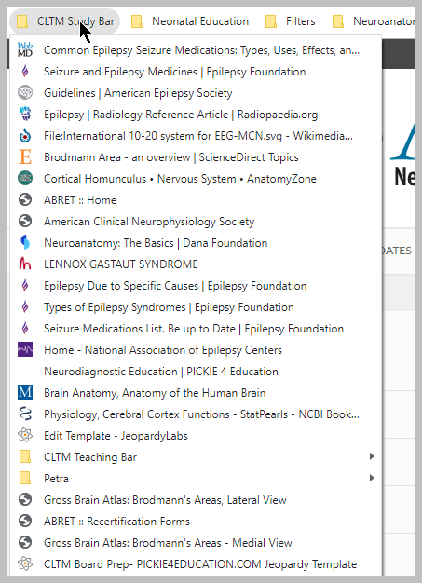
Step 7
Locate online resources.
Books
Credible websites
Study Groups
Guidelines
Policies
Test taking strategies

Slide 10
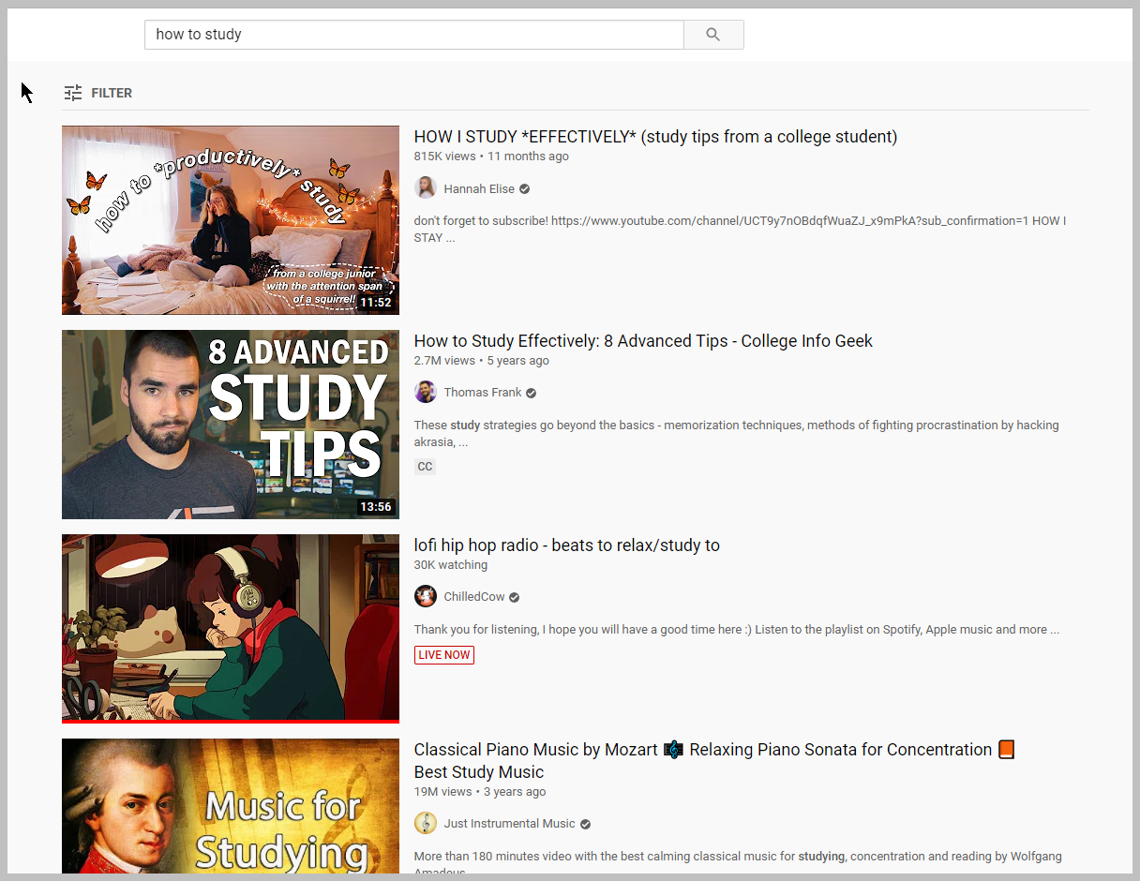
Step 8
Go to YouTube
Find YOUR study music
Research YOUR best way to study
Find videos to help you learn topics

Slide 11
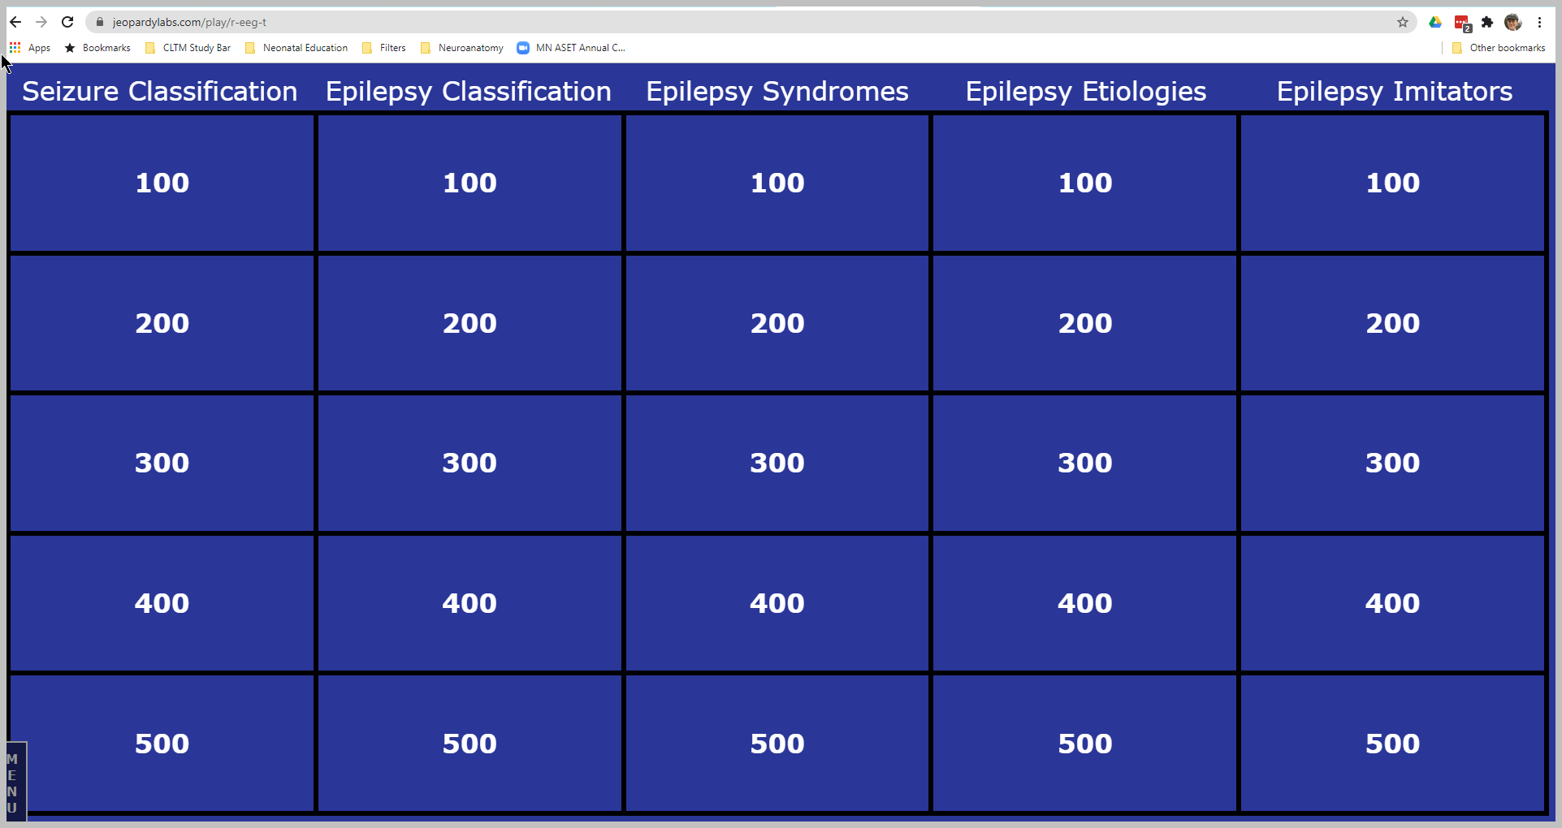
Step 9
Create a jeopardy like game for yourself!
https://jeopardylabs.com/account/home/
The one you see here is free and open to the public.
https://jeopardylabs.com/play/r-eeg-t

Slide 12
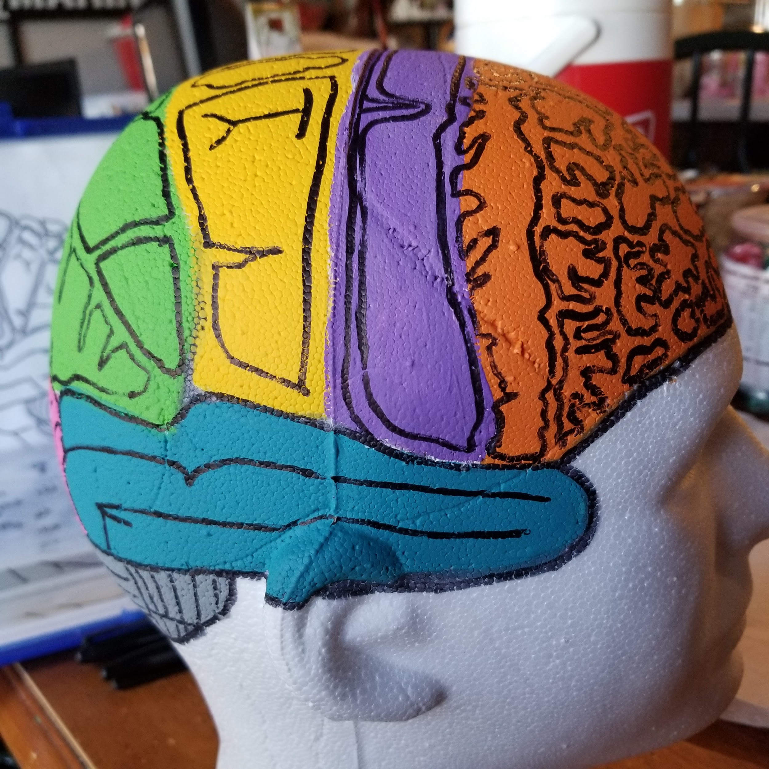
Step 10
Create resources that mean something to you!
What type of learner are you?
Visual
Auditory
multiple

Slide 13
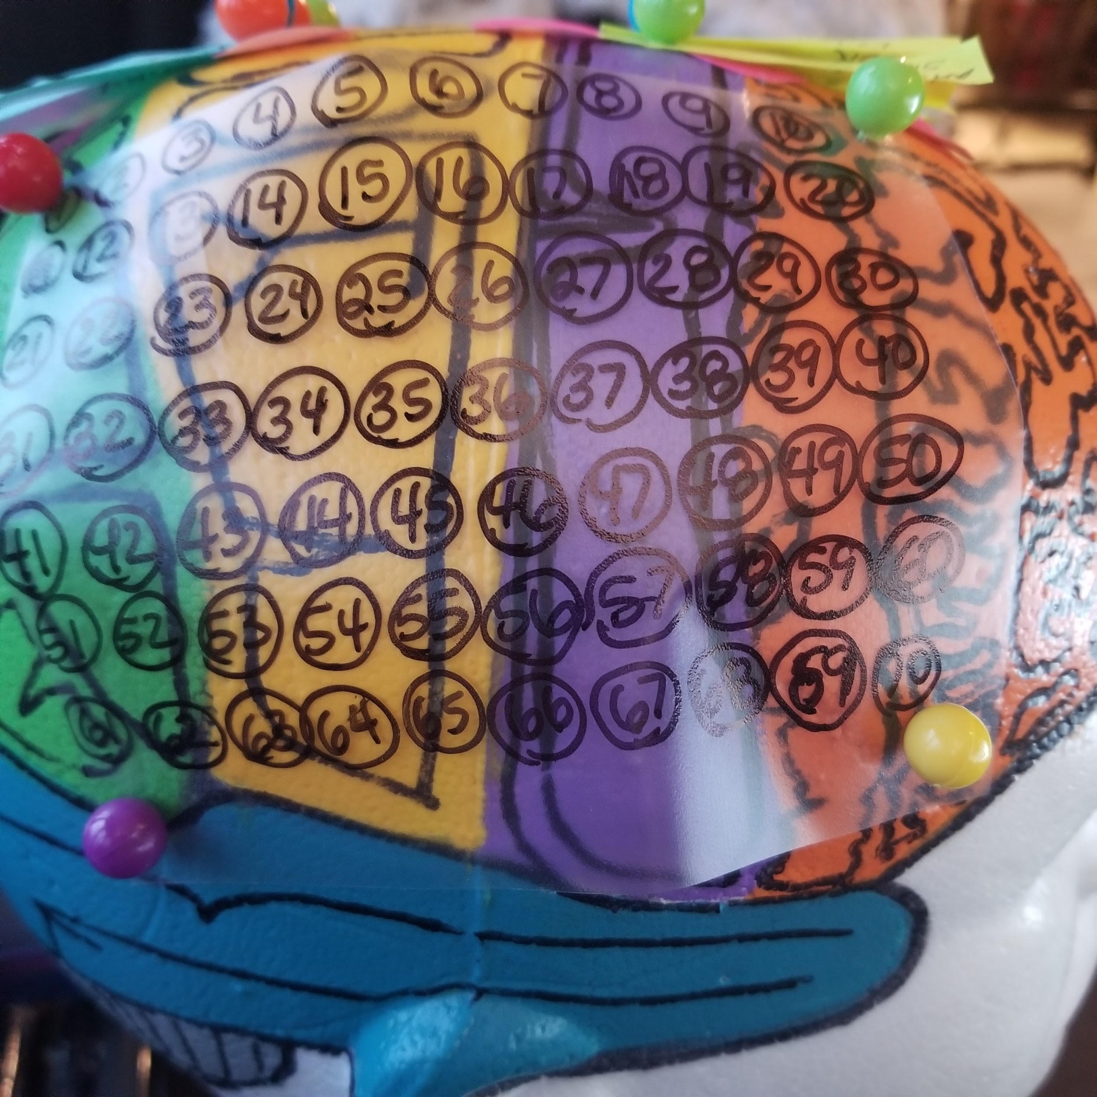
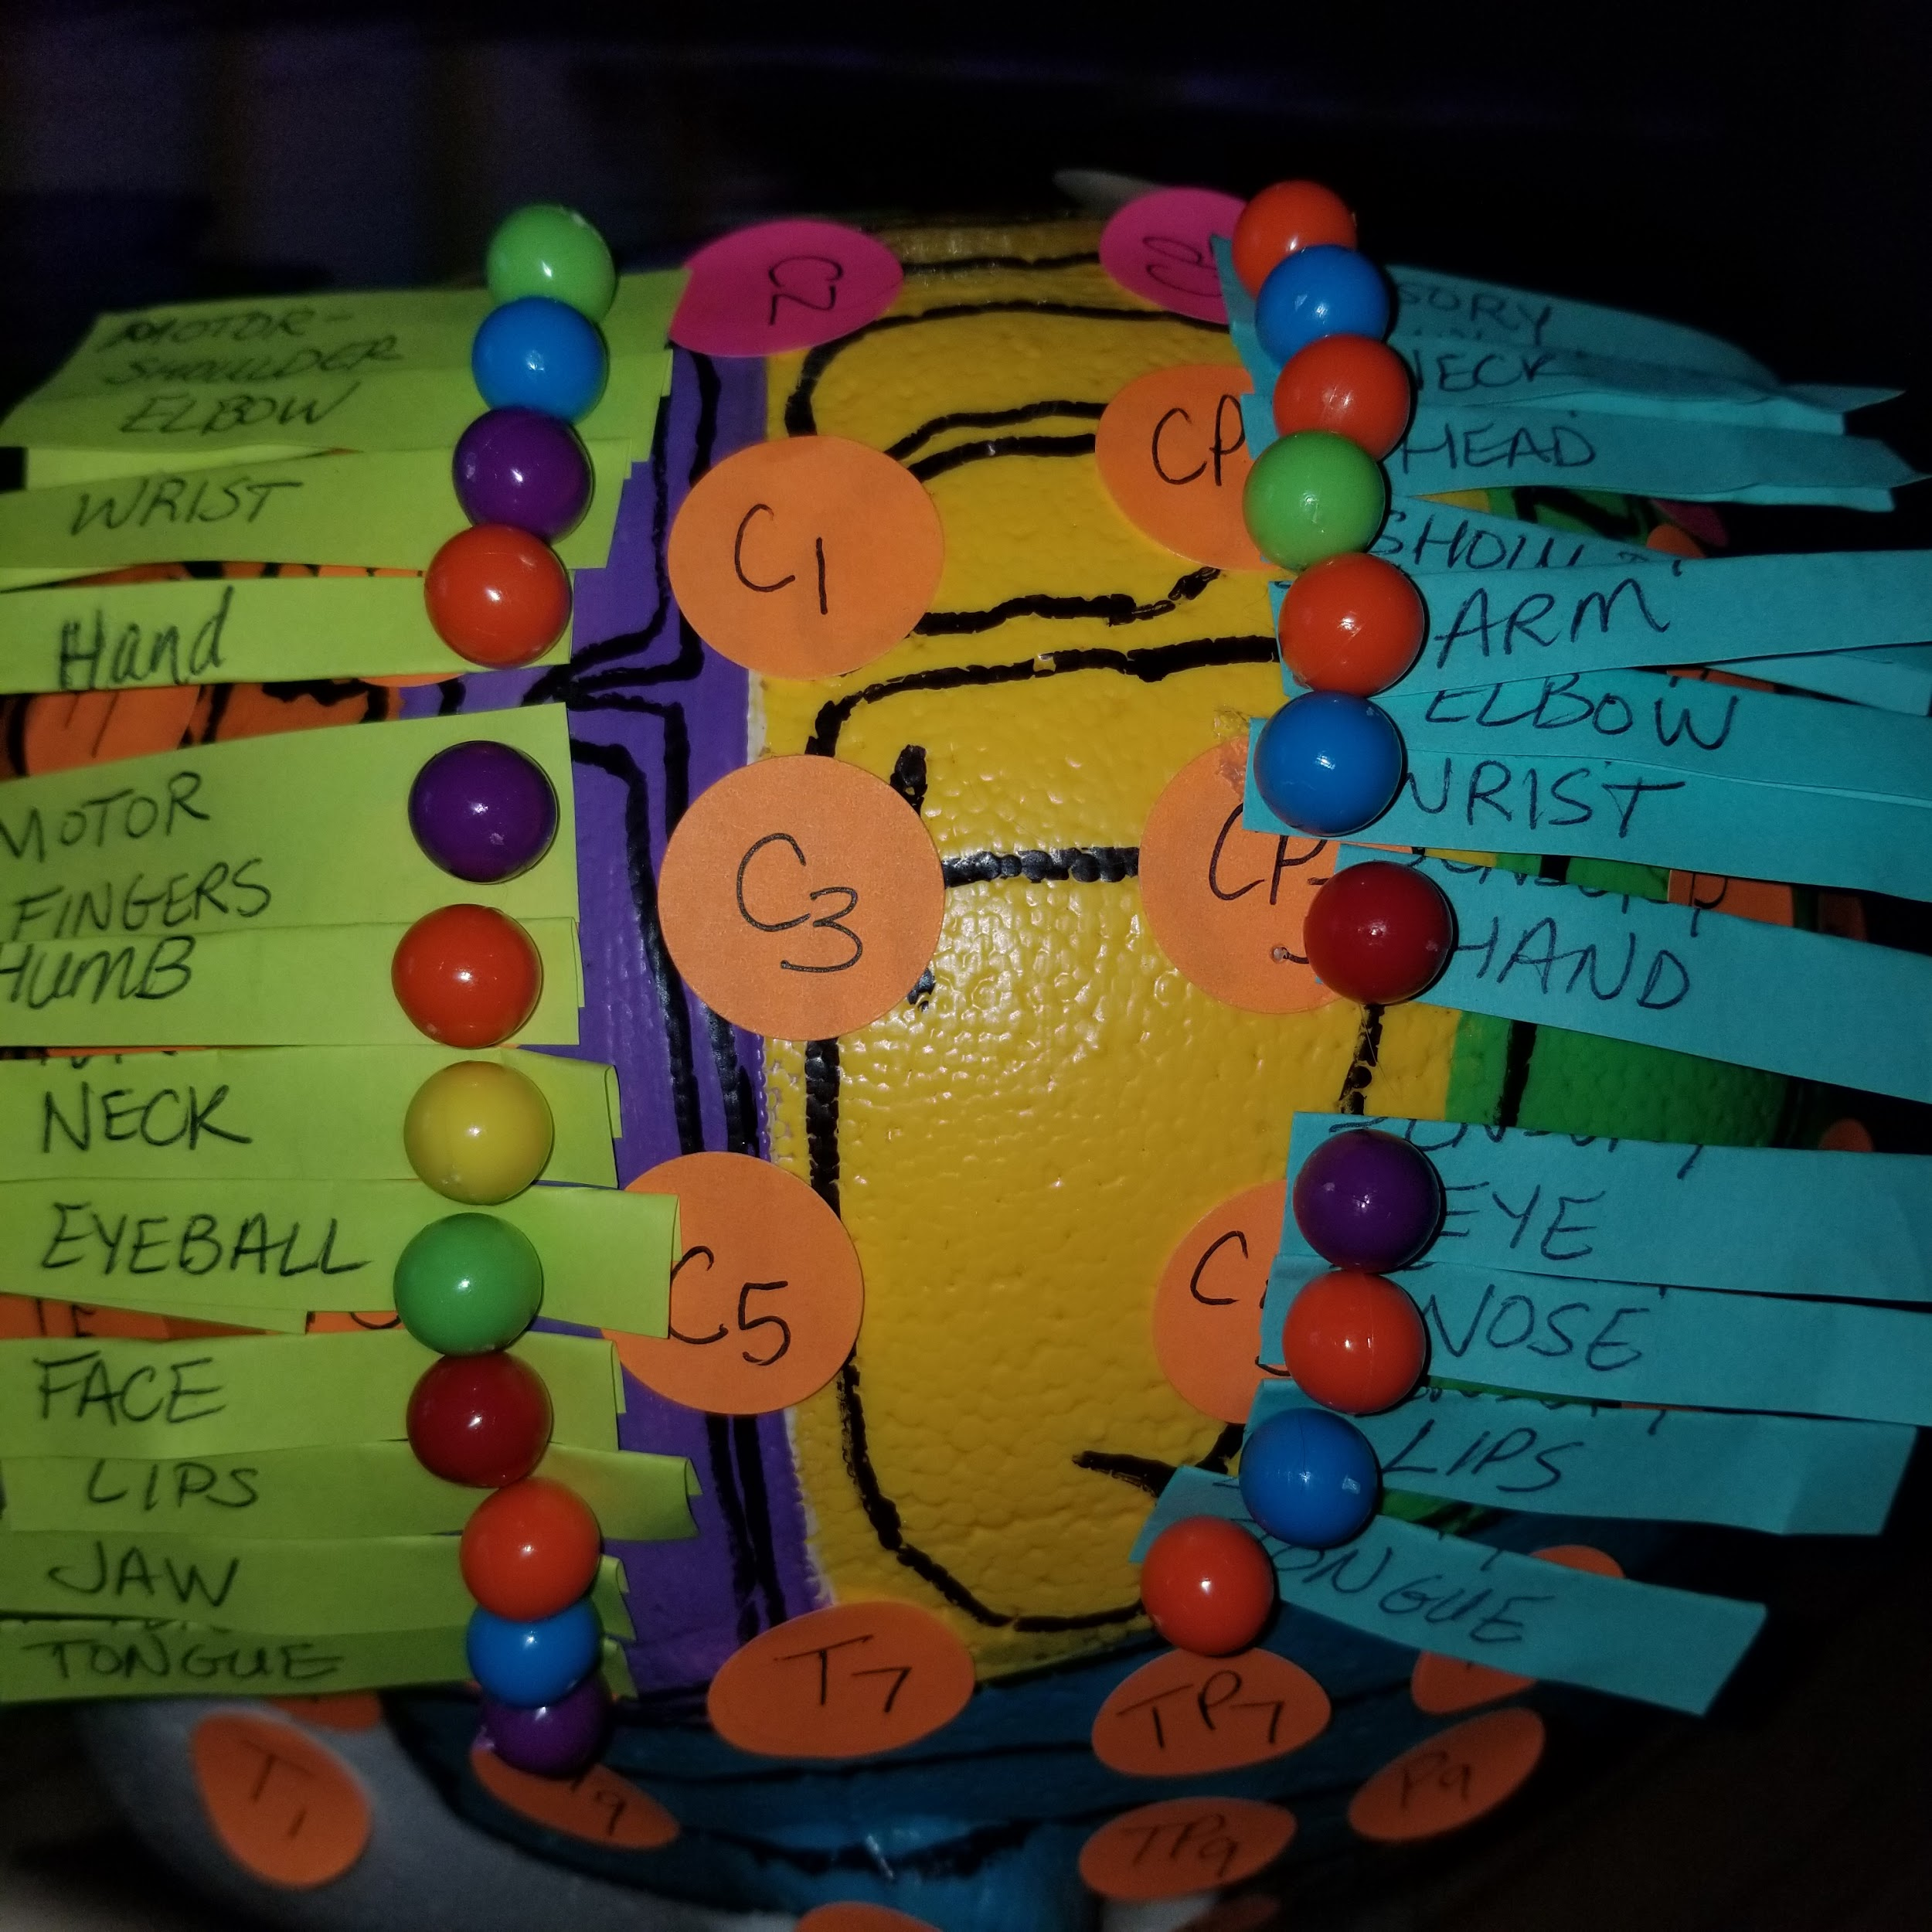
Meet Frank

Slide 14
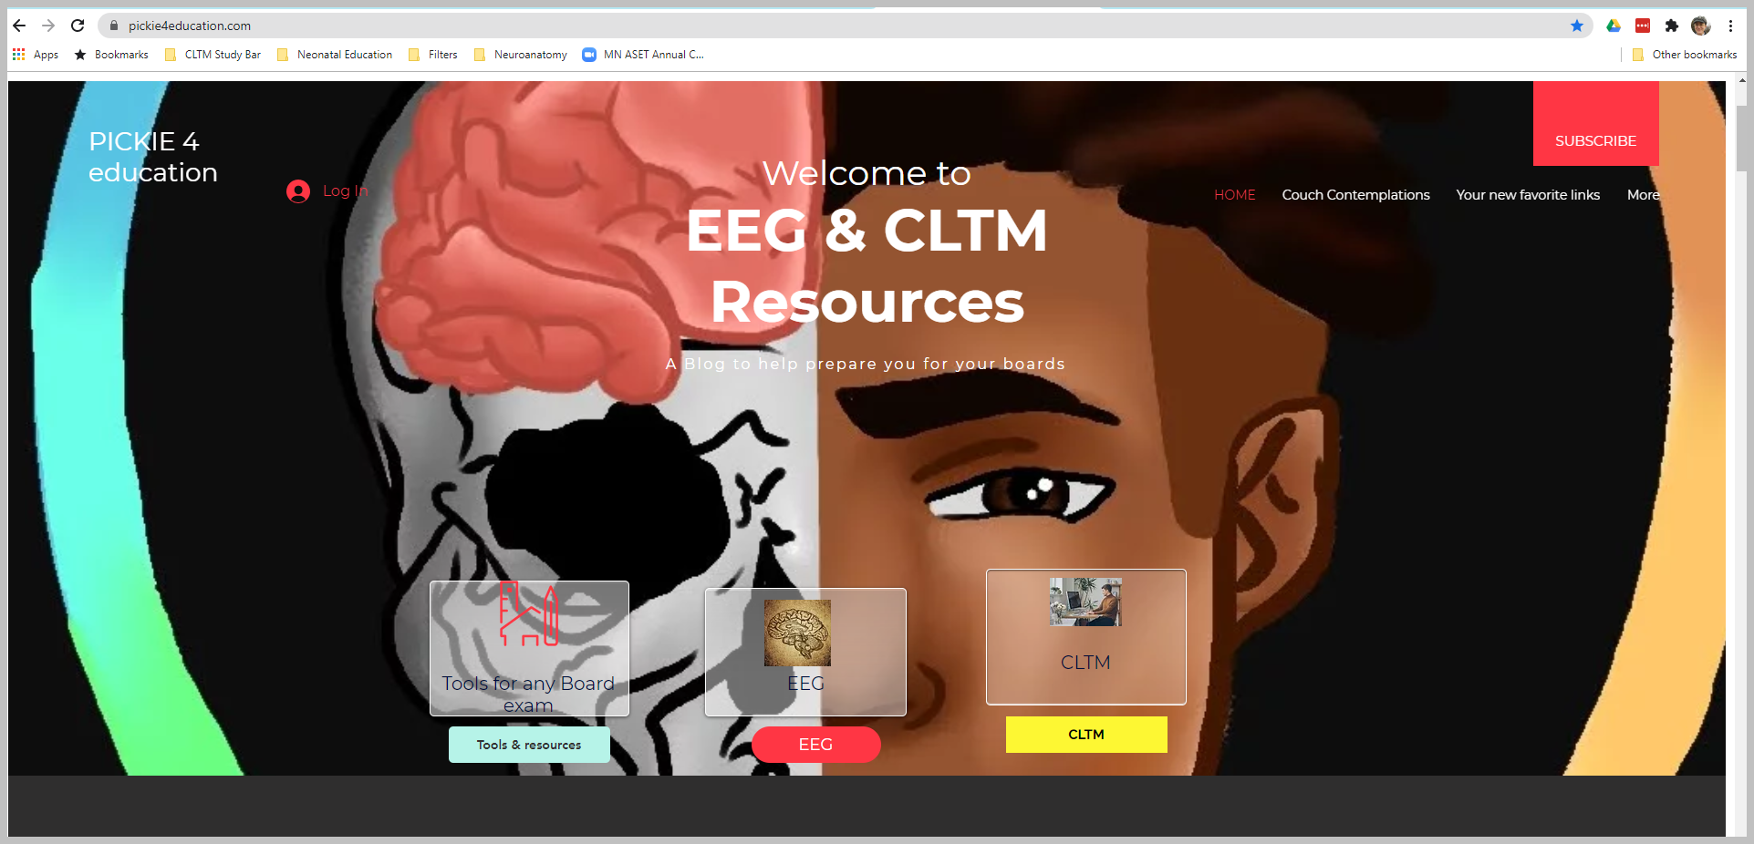
Creating & locating resources

Slide 15
Study & Test Prep
Your study place
Proper Nutrition
Tools for the task

